Slide 1
Query Retrieval Report
5 Representative Cases Across LiTS, Pancreas, and FLARE
200 Structured Queries | 5 Progressive Tiers | 3 Datasets

Slide 2
Background: Progressive Tier Architecture
T1: Tabular Only
→
T2: T1 + Text
→
T3: T2 + CLIP
→
T4: T3 + GNN
→
T5: T4 + VKG
Volume, coverage, distance, tumor counts
Clinical text embeddings (radiology descriptions)
Visual embeddings from 3D scan visualizations
Graph neural network embeddings (topology)
Knowledge graph reasoning (evidence paths, adjacency)
Query Constraint Dimensions
Volume
Tumor volume / burden
Reading the Tier Slides: • Each tier slide shows the top-5 retrieved scans • GREEN border = truly relevant scan • RED border = irrelevant scan • Metric: relevant scans retrieved in top-10 • Scan IDs: F=FLARE, P=Pancreas, plain#=LiTS
Coverage
Tumor coverage within host organ
Proximity
Distance to adjacent structures
Multiplicity
Multi-focal / multi-organ involvement
Containment
Organ topology / evidence paths

Slide 3
Case 1: Single-Constraint — Multiplicity [FLARE]
Natural Language:
"Find scans with multi-focal tumors or multi-organ involvement."
Dataset: FLARE
Constraints: multiplicity
Cardinality: 1
Min Tier: T1
T5 Weight: 0.0%
Relevant: 22/85
Top-10 Relevant Retrieval Across Tiers:
T1: 10/22
T2: 10/22
T3: 10/22
T4: 10/22
T5: 10/22
Key Insight: T1 sufficient — all tiers retrieve 10/10 relevant in top-10. Multiplicity is fully captured by tabular tumor/organ count features.

Slide 4
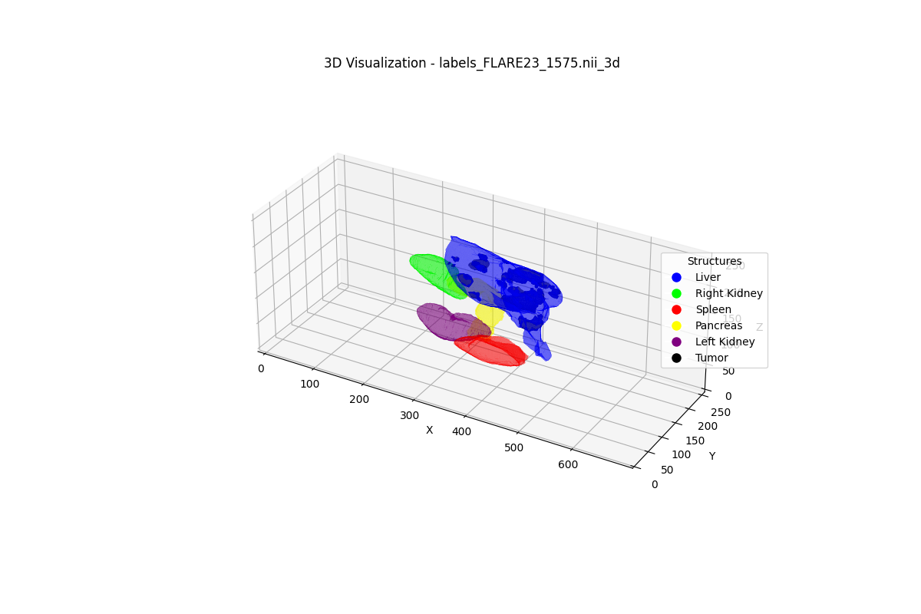
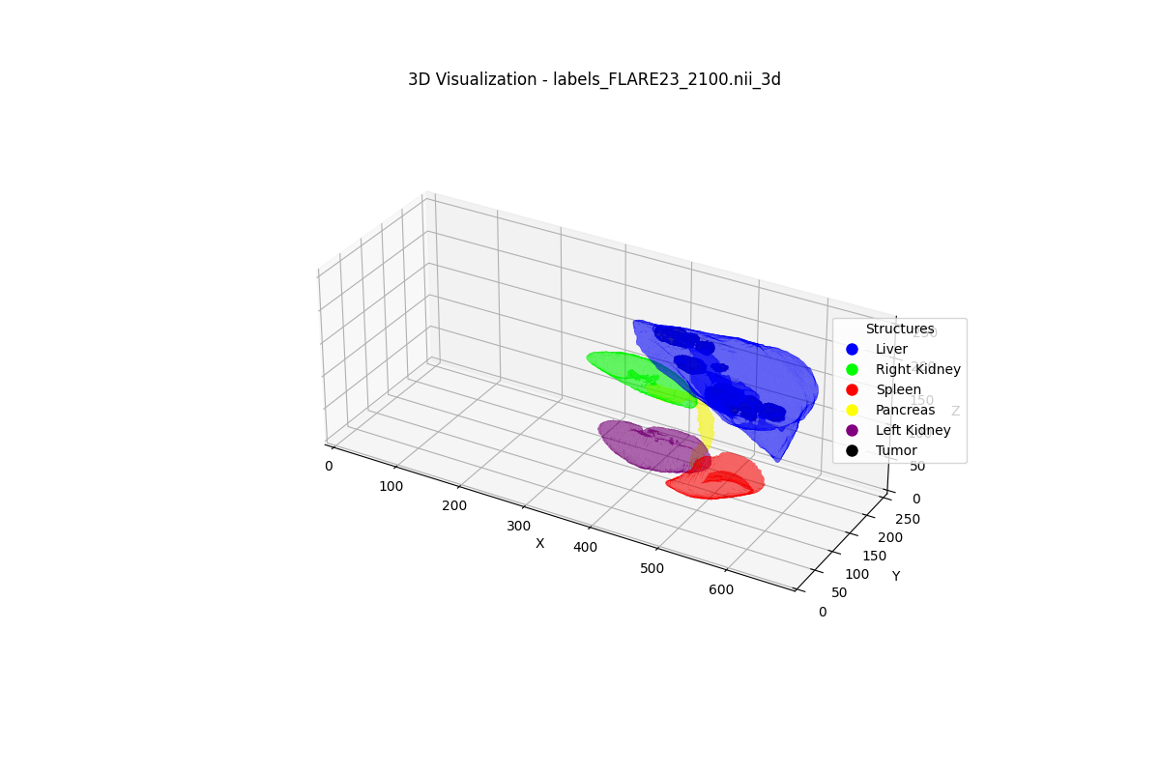
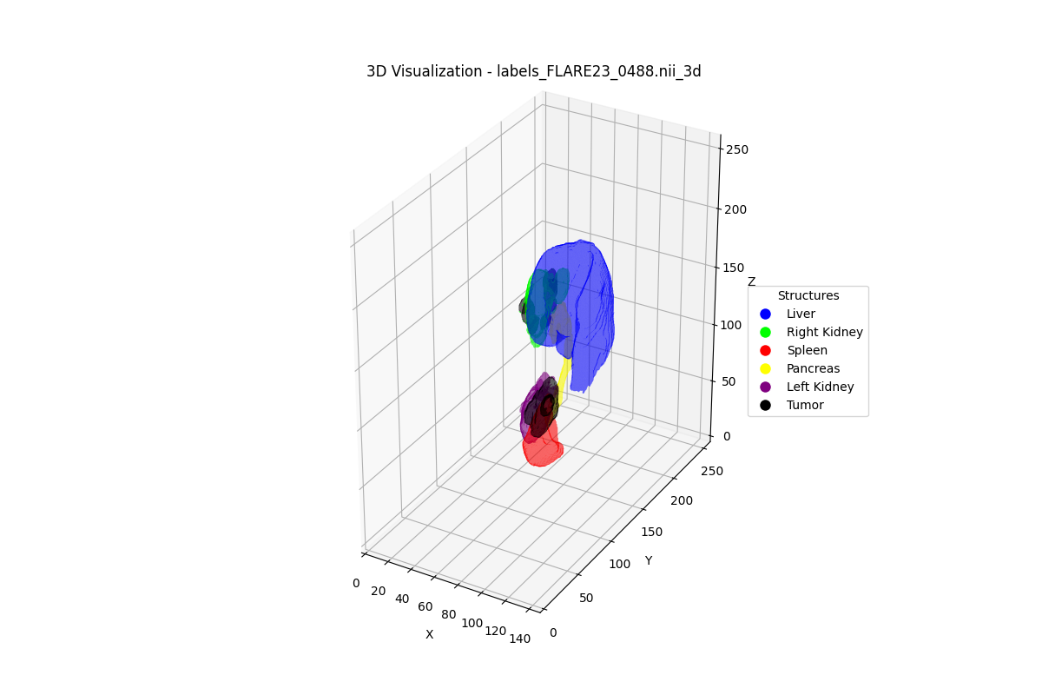
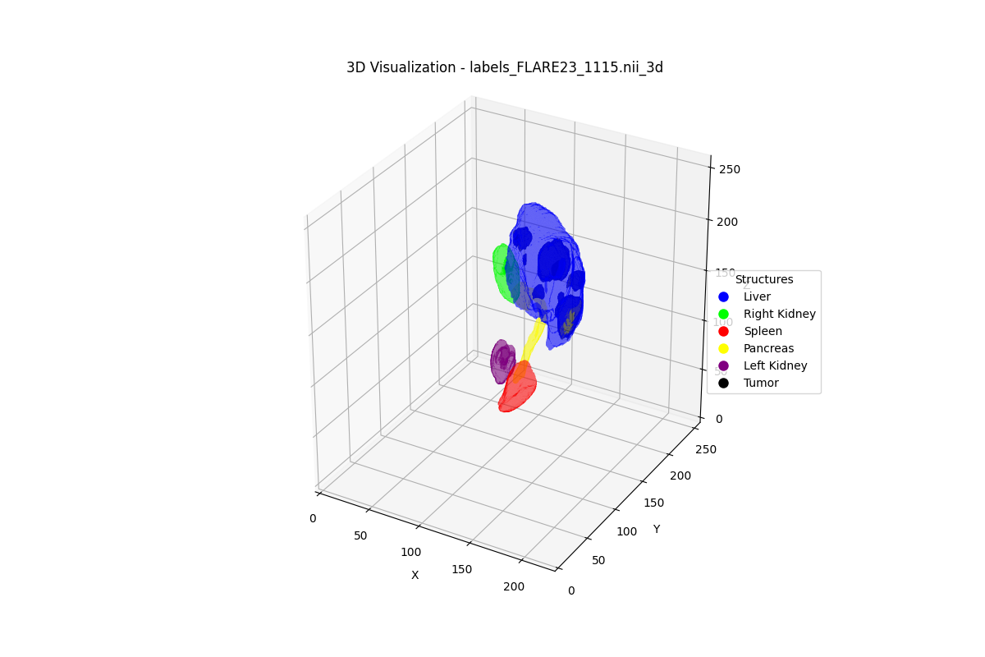
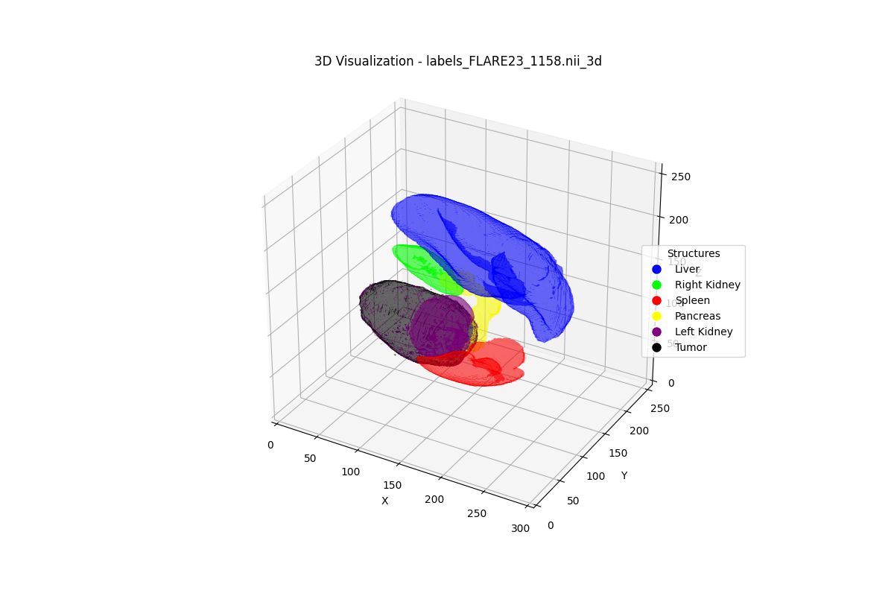
Case 1: Single-Constraint — Multiplicity [FLARE] — T1 Retrieval (10/22 relevant in top-10)
Query: "Find scans with multi-focal tumors or multi-organ involvement."
#1 F1575 [FLARE] (RELEVANT)
#2 F2100 [FLARE] (RELEVANT)
#3 F0488 [FLARE] (RELEVANT)
#4 F1115 [FLARE] (RELEVANT)
#5 F1158 [FLARE] (RELEVANT)
Score: 1.000 | GT: 0.667
Score: 0.980 | GT: 0.667
Score: 0.857 | GT: 0.667
Score: 0.857 | GT: 0.667
Score: 0.639 | GT: 0.333
Ranks 6-10:
*#6 F0689 (score=0.596)
*#7 F0487 (score=0.587)
*#8 F0955 (score=0.540)
*#9 F2175 (score=0.525)
*#10 F1474 (score=0.440)

Slide 5
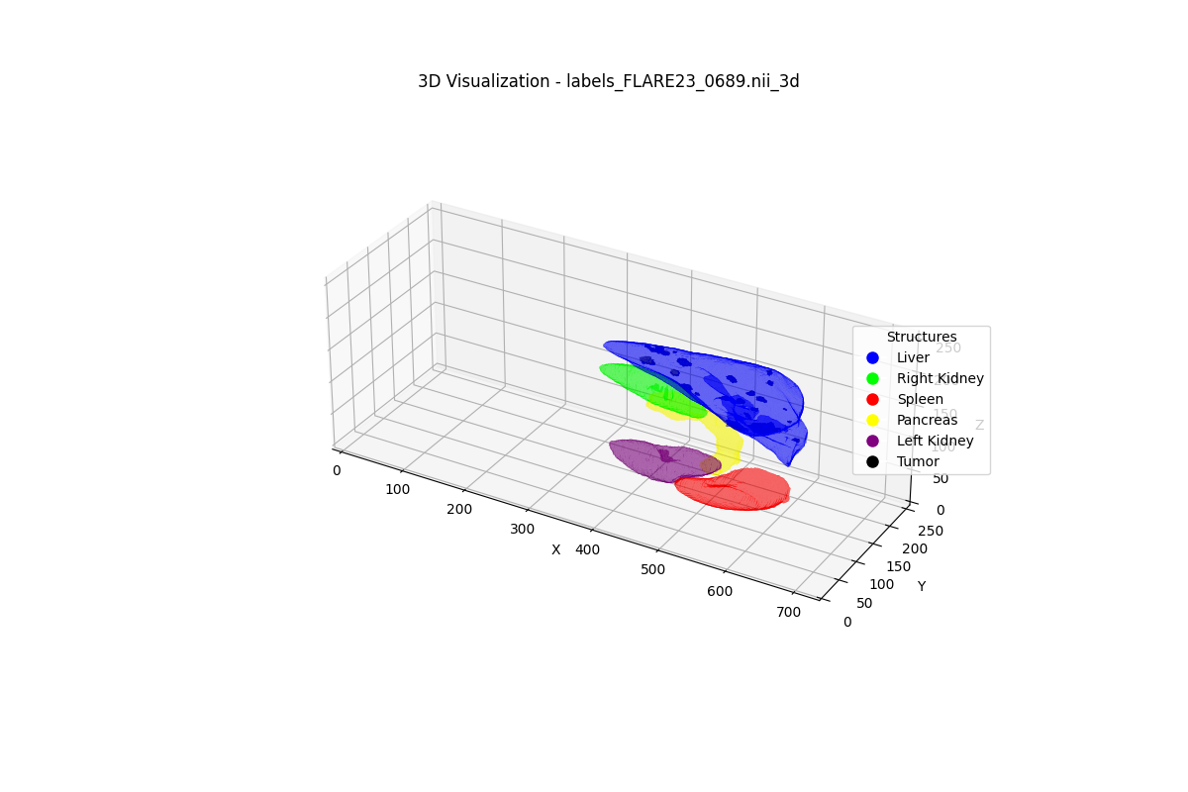
Case 1: Single-Constraint — Multiplicity [FLARE] — T2 Retrieval (10/22 relevant in top-10)
Query: "Find scans with multi-focal tumors or multi-organ involvement."
#1 F2100 [FLARE] (RELEVANT)
#2 F1575 [FLARE] (RELEVANT)
#3 F1115 [FLARE] (RELEVANT)
#4 F0488 [FLARE] (RELEVANT)
#5 F0689 [FLARE] (RELEVANT)
Score: 0.996 | GT: 0.667
Score: 0.971 | GT: 0.667
Score: 0.906 | GT: 0.667
Score: 0.855 | GT: 0.667
Score: 0.636 | GT: 0.333
Ranks 6-10:
*#6 F1158 (score=0.625)
*#7 F0487 (score=0.548)
*#8 F2175 (score=0.525)
*#9 F0955 (score=0.524)
*#10 F1474 (score=0.503)

Slide 6
Case 1: Single-Constraint — Multiplicity [FLARE] — T3 Retrieval (10/22 relevant in top-10)
Query: "Find scans with multi-focal tumors or multi-organ involvement."
#1 F2100 [FLARE] (RELEVANT)
#2 F1575 [FLARE] (RELEVANT)
#3 F1115 [FLARE] (RELEVANT)
#4 F0488 [FLARE] (RELEVANT)
#5 F0689 [FLARE] (RELEVANT)
Score: 0.995 | GT: 0.667
Score: 0.969 | GT: 0.667
Score: 0.896 | GT: 0.667
Score: 0.862 | GT: 0.667
Score: 0.633 | GT: 0.333
Ranks 6-10:
*#6 F1158 (score=0.620)
*#7 F1474 (score=0.560)
*#8 F0487 (score=0.551)
*#9 F0955 (score=0.541)
*#10 F2175 (score=0.534)

Slide 7
Case 1: Single-Constraint — Multiplicity [FLARE] — T4 Retrieval (10/22 relevant in top-10)
Query: "Find scans with multi-focal tumors or multi-organ involvement."
#1 F1575 [FLARE] (RELEVANT)
#2 F2100 [FLARE] (RELEVANT)
#3 F0488 [FLARE] (RELEVANT)
#4 F1115 [FLARE] (RELEVANT)
#5 F0689 [FLARE] (RELEVANT)
Score: 1.000 | GT: 0.667
Score: 0.991 | GT: 0.667
Score: 0.934 | GT: 0.667
Score: 0.886 | GT: 0.667
Score: 0.650 | GT: 0.333
Ranks 6-10:
*#6 F0487 (score=0.578)
*#7 F2175 (score=0.555)
*#8 F1158 (score=0.522)
*#9 F1474 (score=0.494)
*#10 F0083 (score=0.477)

Slide 8
Case 1: Single-Constraint — Multiplicity [FLARE] — T5 Retrieval (10/22 relevant in top-10)
Query: "Find scans with multi-focal tumors or multi-organ involvement."
#1 F2100 [FLARE] (RELEVANT)
#2 F1575 [FLARE] (RELEVANT)
#3 F0488 [FLARE] (RELEVANT)
#4 F1115 [FLARE] (RELEVANT)
#5 F0689 [FLARE] (RELEVANT)
Score: 0.998 | GT: 0.667
Score: 0.975 | GT: 0.667
Score: 0.957 | GT: 0.667
Score: 0.921 | GT: 0.667
Score: 0.576 | GT: 0.333
Ranks 6-10:
*#6 F0487 (score=0.537)
*#7 F2175 (score=0.505)
*#8 F1158 (score=0.502)
*#9 F1474 (score=0.496)
*#10 F0083 (score=0.487)

Slide 9
Case 2: Biggest T5 Gain — Coverage + Proximity [Pancreas]
Natural Language:
"Find scans with high tumor coverage AND close proximity to adjacent structures."
Dataset: Pancreas
Constraints: coverage_proximity
Cardinality: 2
Min Tier: T5
T5 Weight: 38.0%
Relevant: 14/57
Top-10 Relevant Retrieval Across Tiers:
T1: 4/14
T2: 2/14
T3: 10/14
T4: 10/14
T5: 10/14
Key Insight: Biggest gain across all datasets (4→10 relevant). CLIP is the key unlock: 8 new relevant scans flood top-10 at T3.

Slide 10
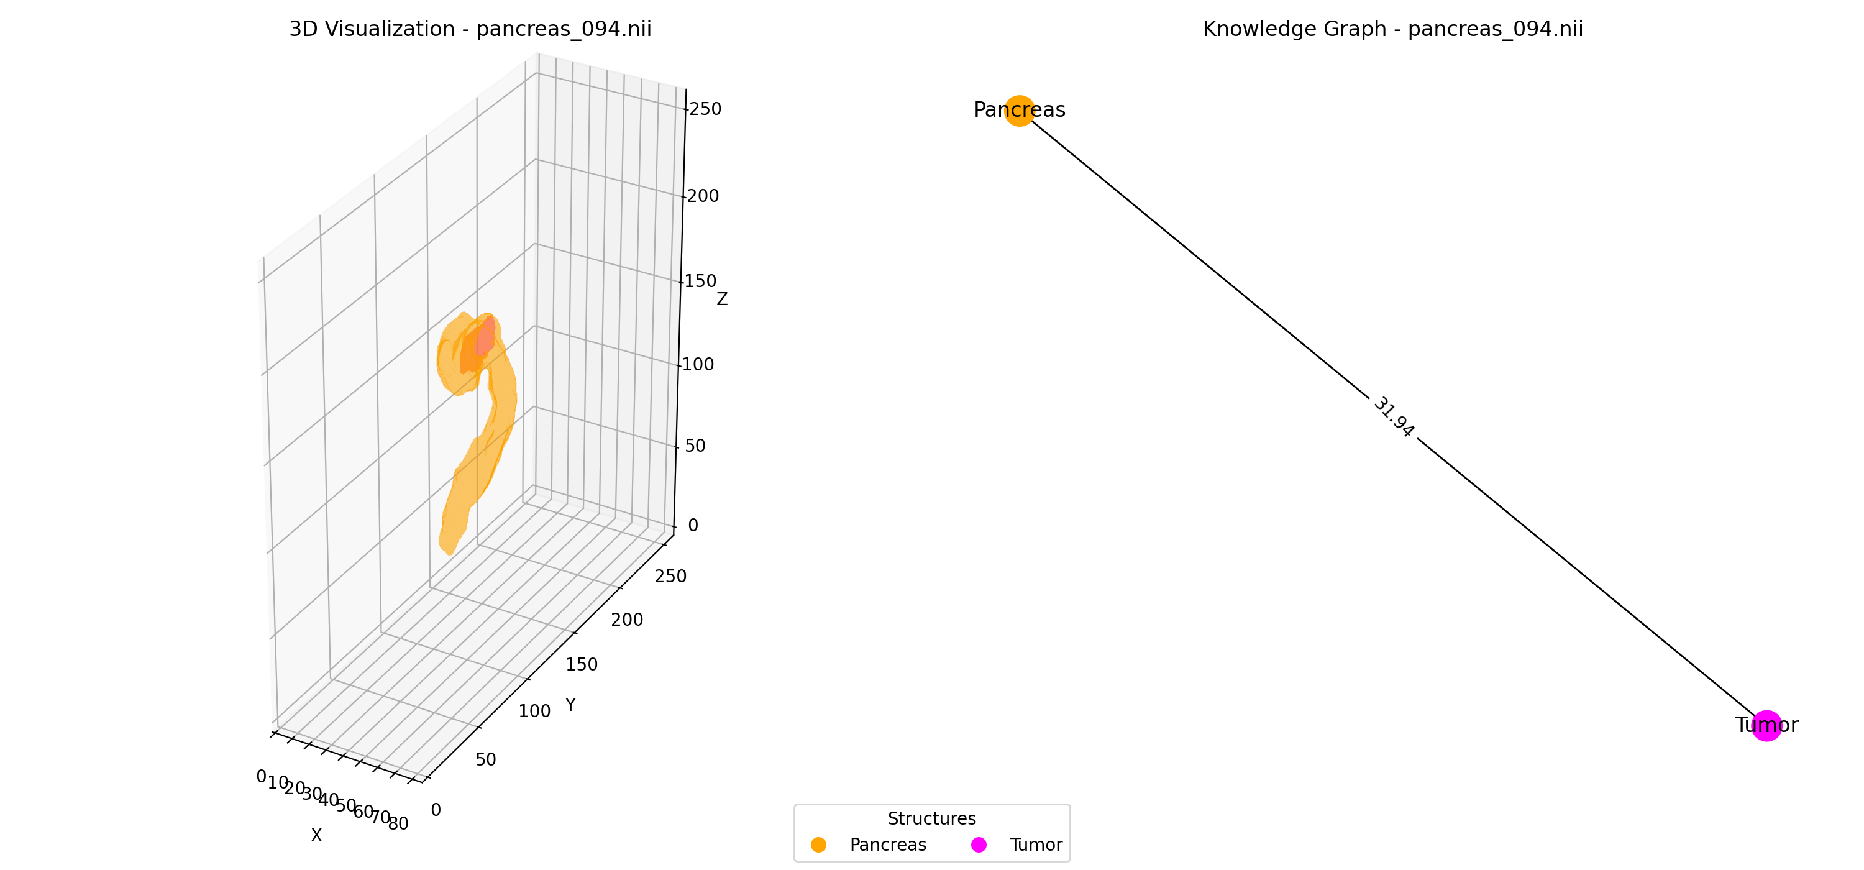
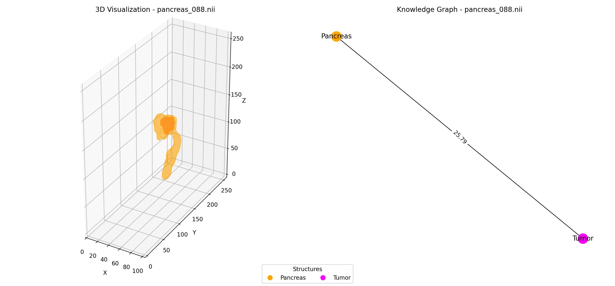
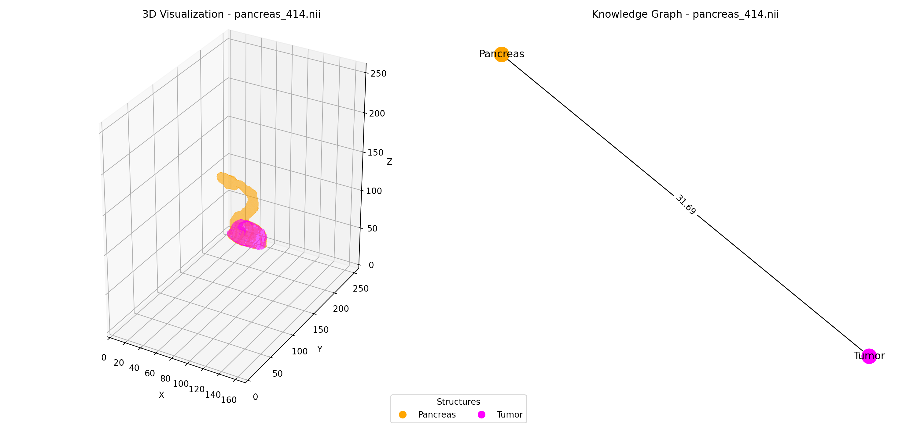
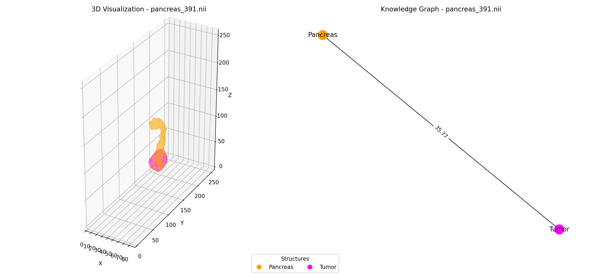
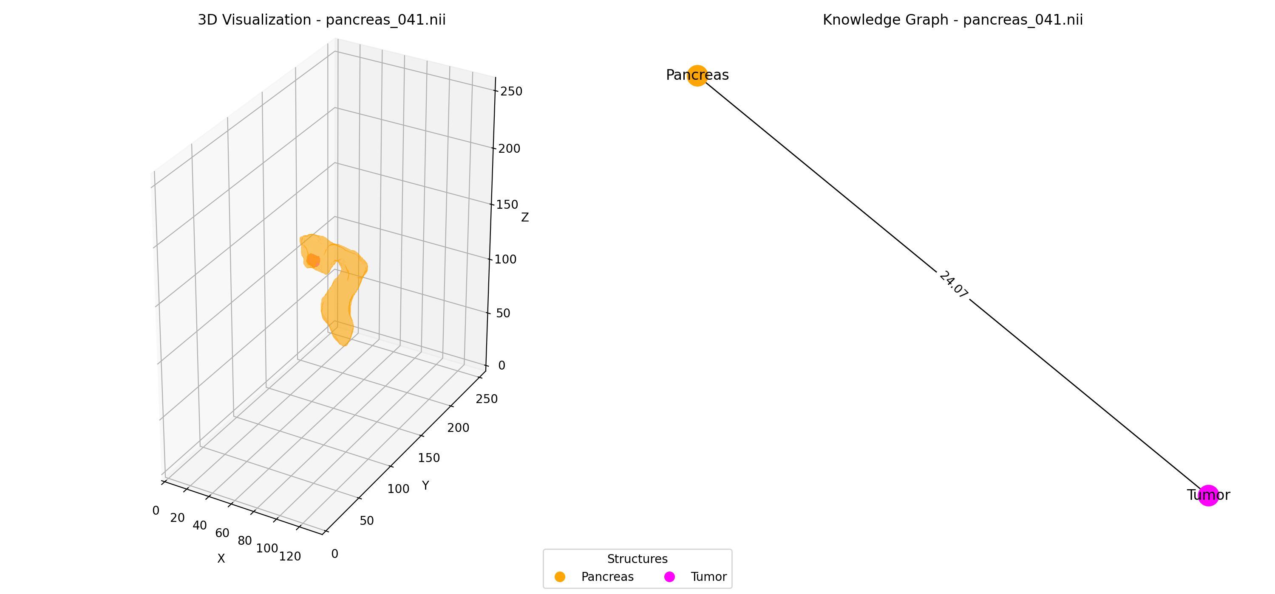
Case 2: Biggest T5 Gain — Coverage + Proximity [Pancreas] — T1 Retrieval (4/14 relevant in top-10)
Query: "Find scans with high tumor coverage AND close proximity to adjacent structures."
#1 P094 [Pancreas] (irrelevant)
#2 P088 [Pancreas] (irrelevant)
#3 P414 [Pancreas] (RELEVANT)
#4 P391 [Pancreas] (irrelevant)
#5 P041 [Pancreas] (RELEVANT)
Score: 0.978 | GT: 0.073
Score: 0.956 | GT: 0.231
Score: 0.928 | GT: 0.501
Score: 0.909 | GT: 0.261
Score: 0.895 | GT: 0.582
Ranks 6-10:
*#6 P012 (score=0.781)
#7 P071 (score=0.704)
*#8 P131 (score=0.618)
#9 P086 (score=0.595)
#10 P405 (score=0.534)

Slide 11
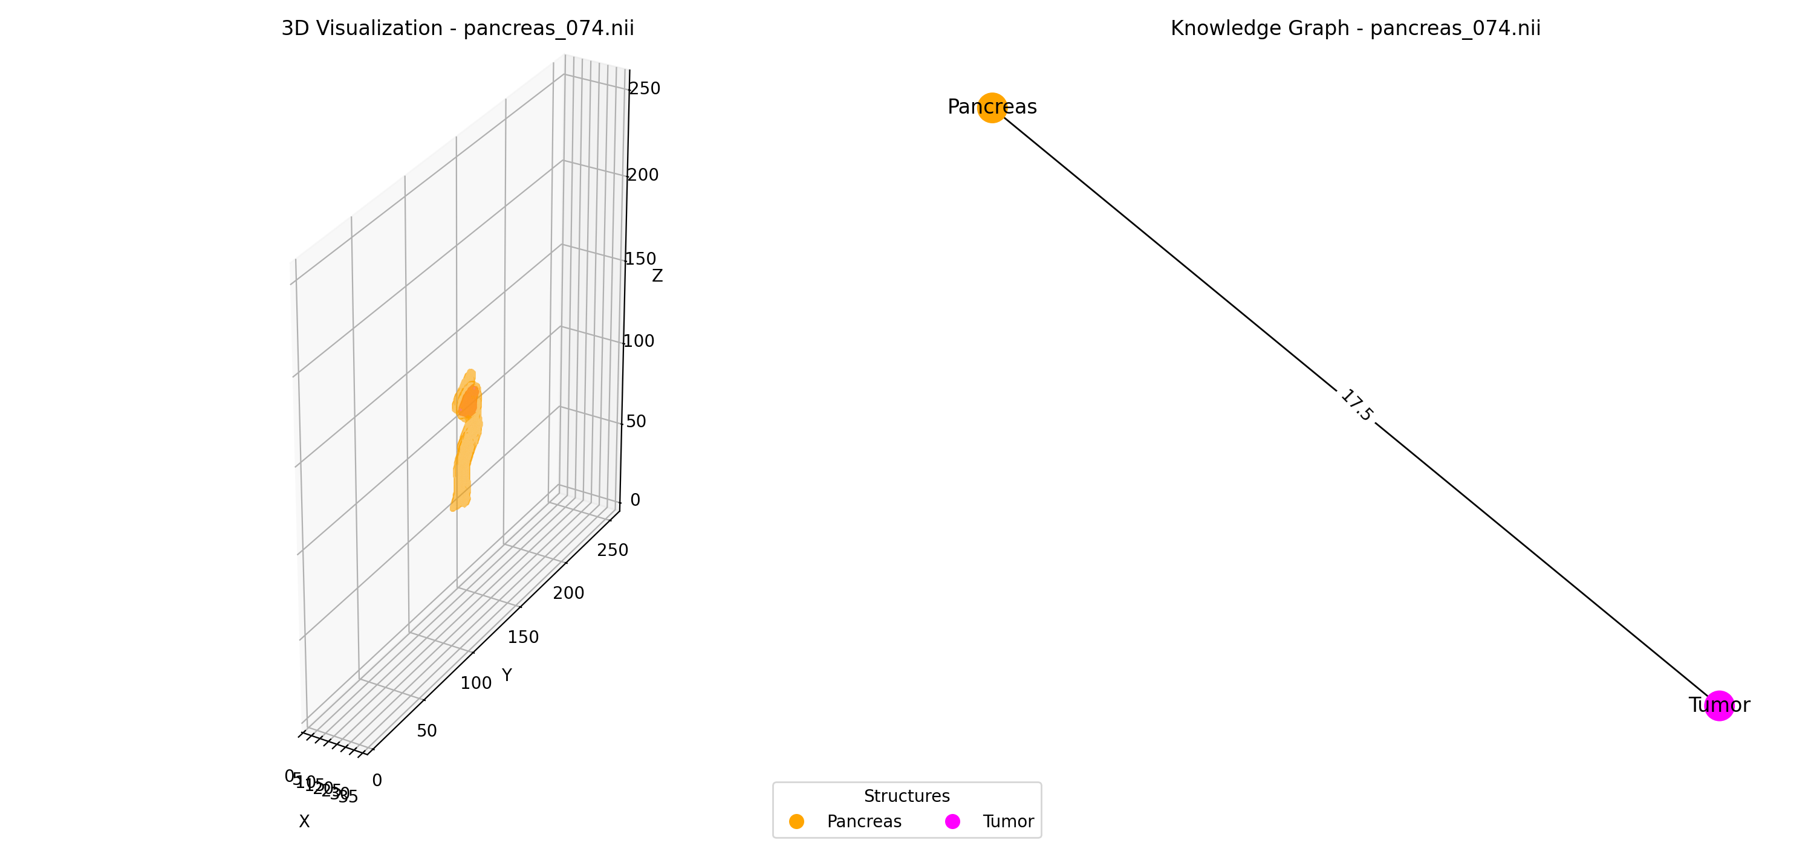
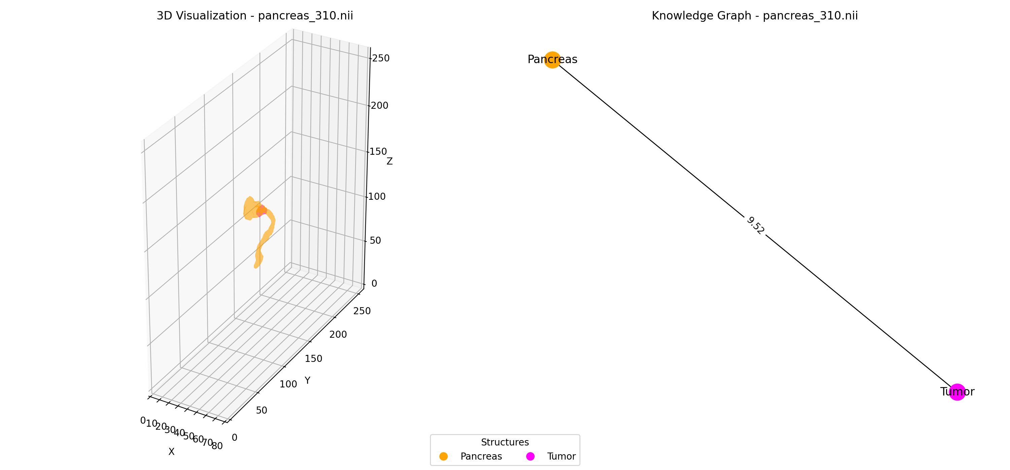
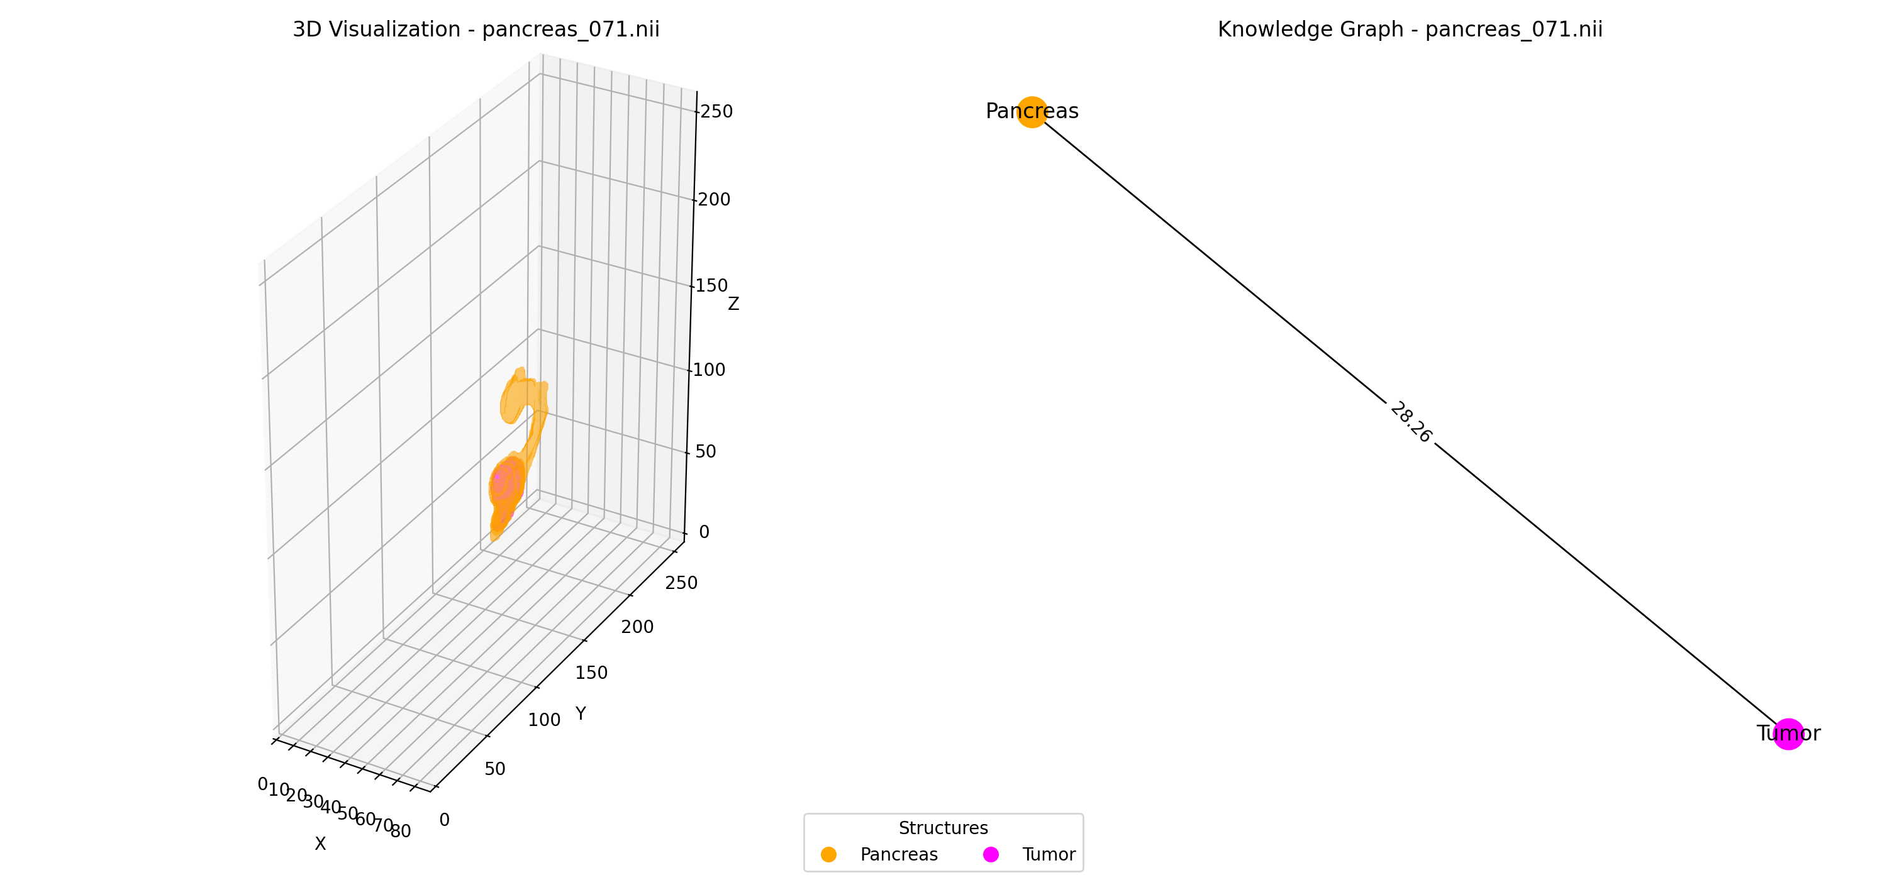
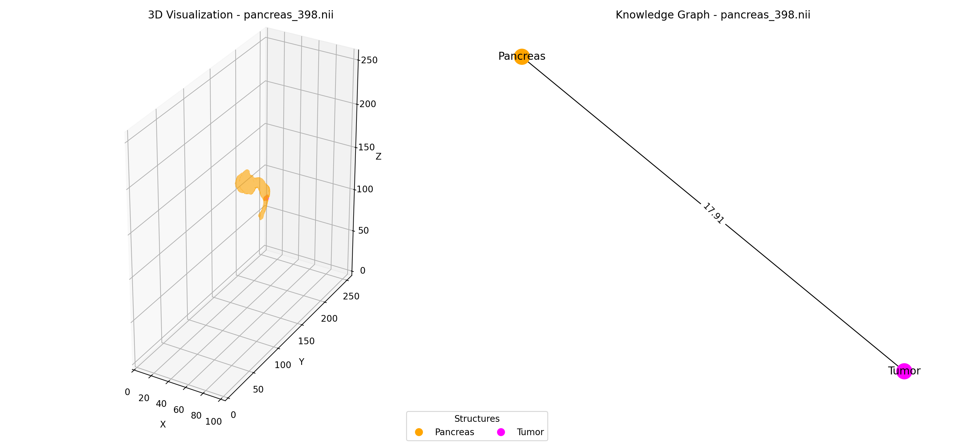
Case 2: Biggest T5 Gain — Coverage + Proximity [Pancreas] — T2 Retrieval (2/14 relevant in top-10)
Query: "Find scans with high tumor coverage AND close proximity to adjacent structures."
#1 P074 [Pancreas] (irrelevant)
#2 P310 [Pancreas] (irrelevant)
#3 P071 [Pancreas] (irrelevant)
#4 P398 [Pancreas] (RELEVANT)
#5 P391 [Pancreas] (irrelevant)
Score: 0.949 | GT: 0.212
Score: 0.869 | GT: 0.283
Score: 0.859 | GT: 0.309
Score: 0.847 | GT: 0.474
Score: 0.800 | GT: 0.261
Ranks 6-10:
#6 P157 (score=0.789)
#7 P350 (score=0.736)
*#8 P012 (score=0.691)
#9 P094 (score=0.684)
#10 P231 (score=0.664)

Slide 12
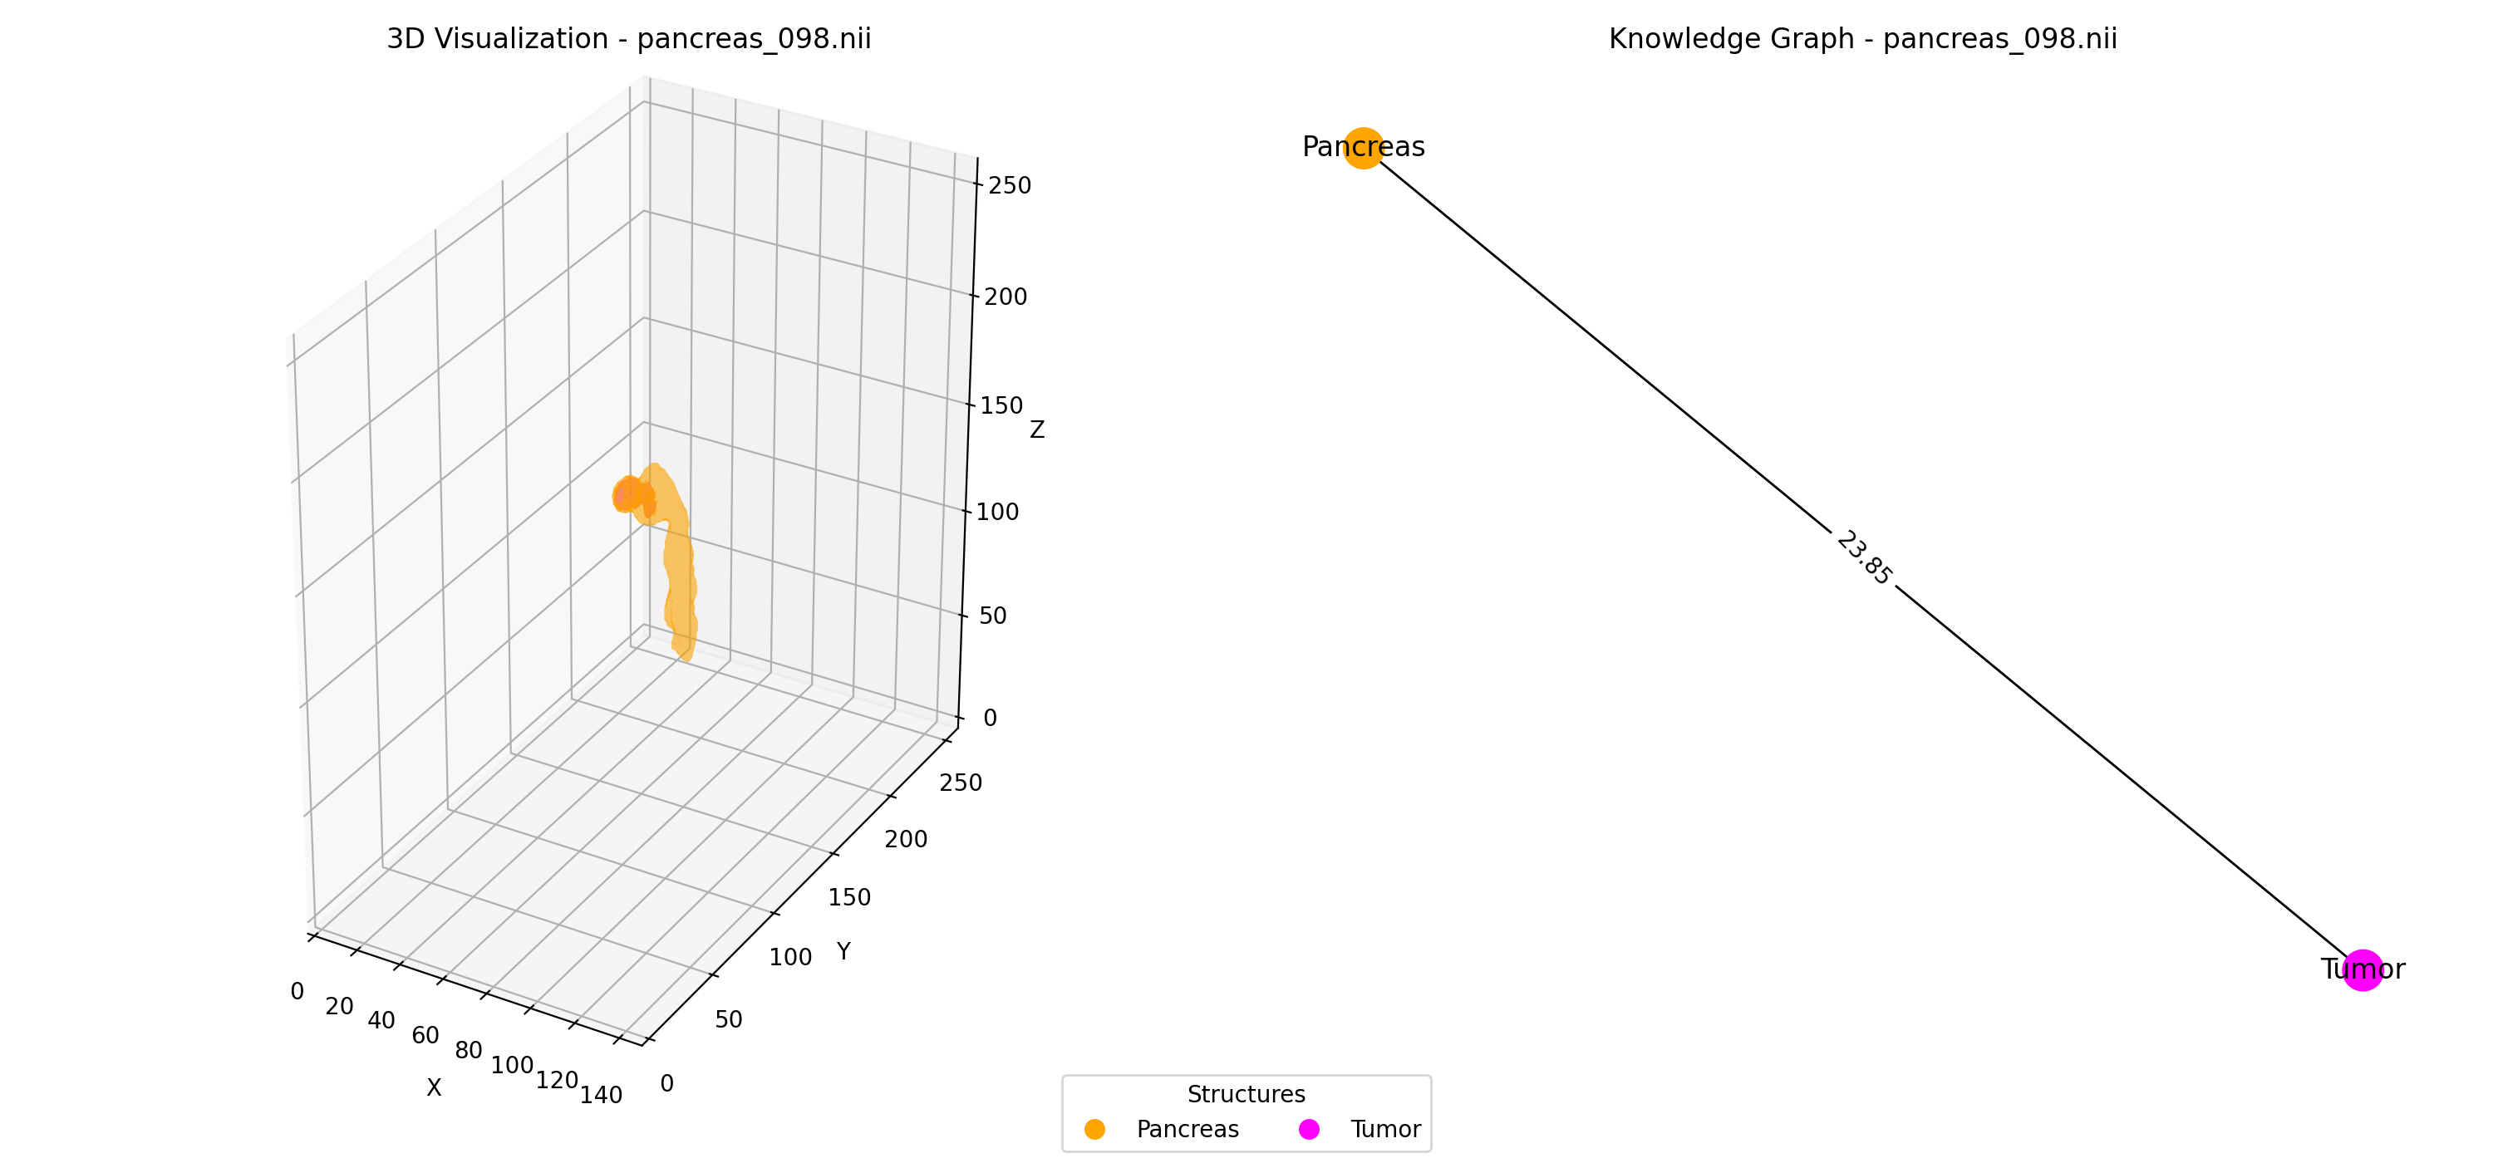
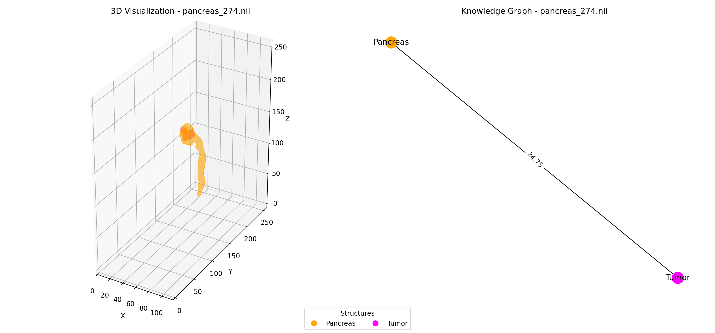
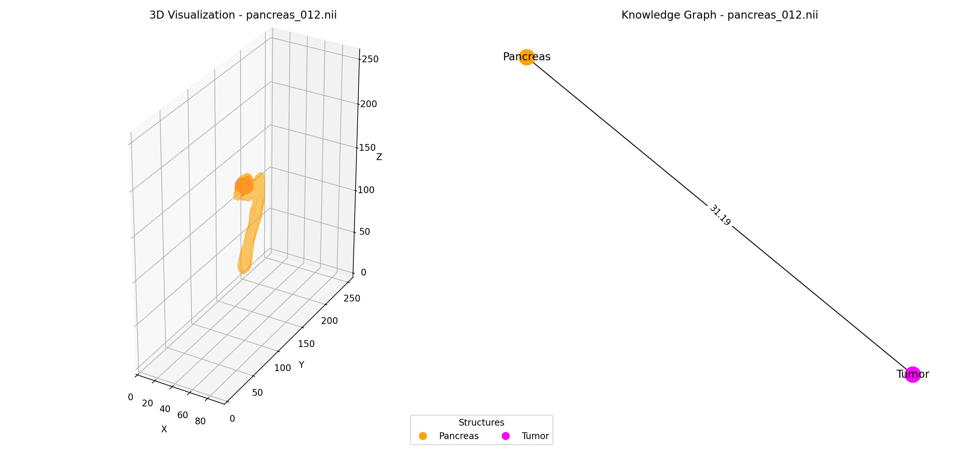
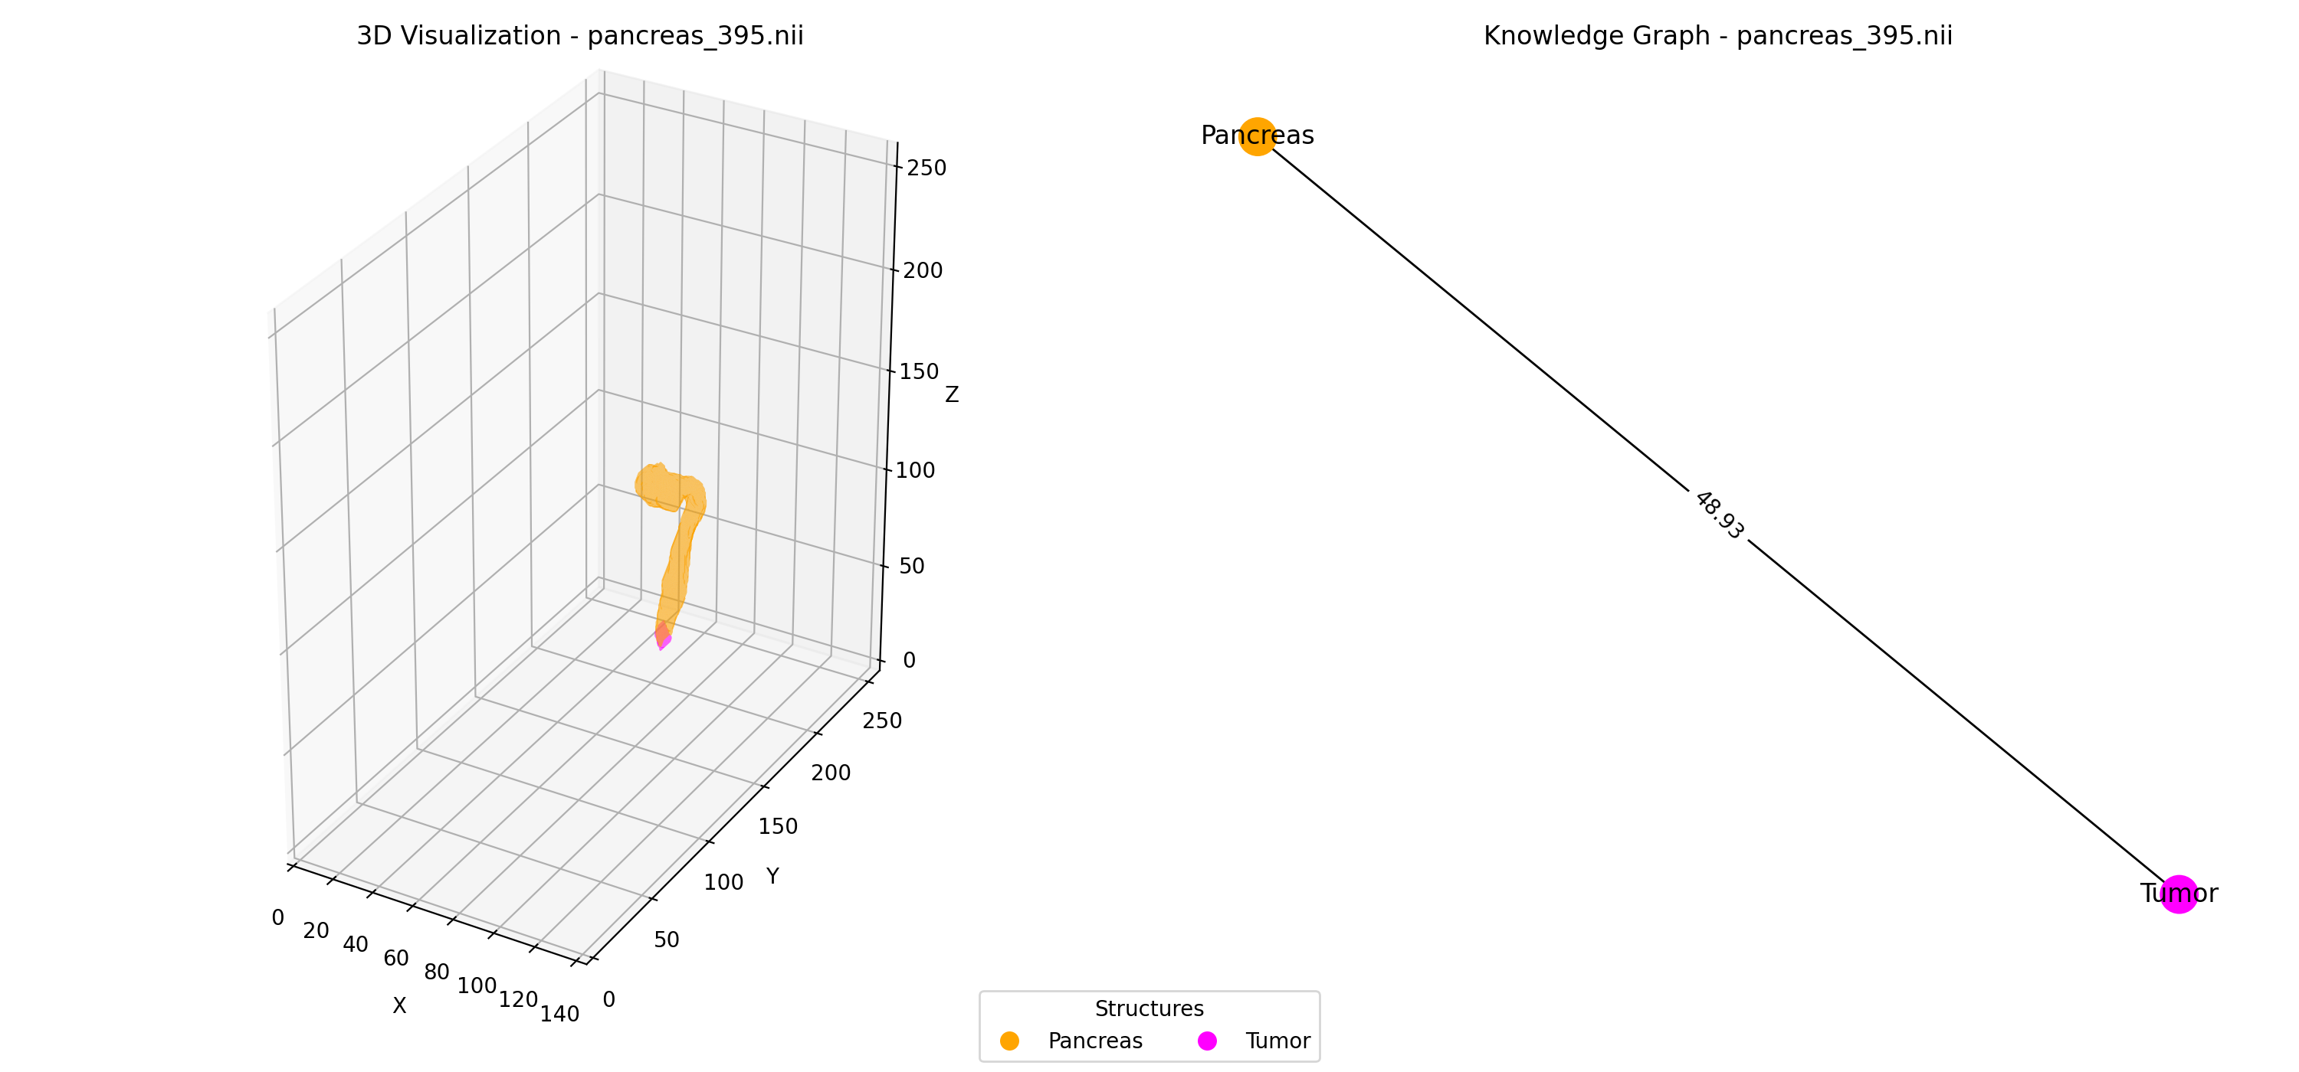
Case 2: Biggest T5 Gain — Coverage + Proximity [Pancreas] — T3 Retrieval (10/14 relevant in top-10)
Query: "Find scans with high tumor coverage AND close proximity to adjacent structures."
#1 P098 [Pancreas] (RELEVANT)
#2 P041 [Pancreas] (RELEVANT)
#3 P274 [Pancreas] (RELEVANT)
#4 P012 [Pancreas] (RELEVANT)
#5 P395 [Pancreas] (RELEVANT)
Score: 0.978 | GT: 0.566
Score: 0.974 | GT: 0.582
Score: 0.920 | GT: 0.550
Score: 0.919 | GT: 0.469
Score: 0.872 | GT: 0.493
Ranks 6-10:
*#6 P398 (score=0.852)
*#7 P107 (score=0.845)
*#8 P122 (score=0.841)
*#9 P125 (score=0.826)
*#10 P414 (score=0.816)

Slide 13
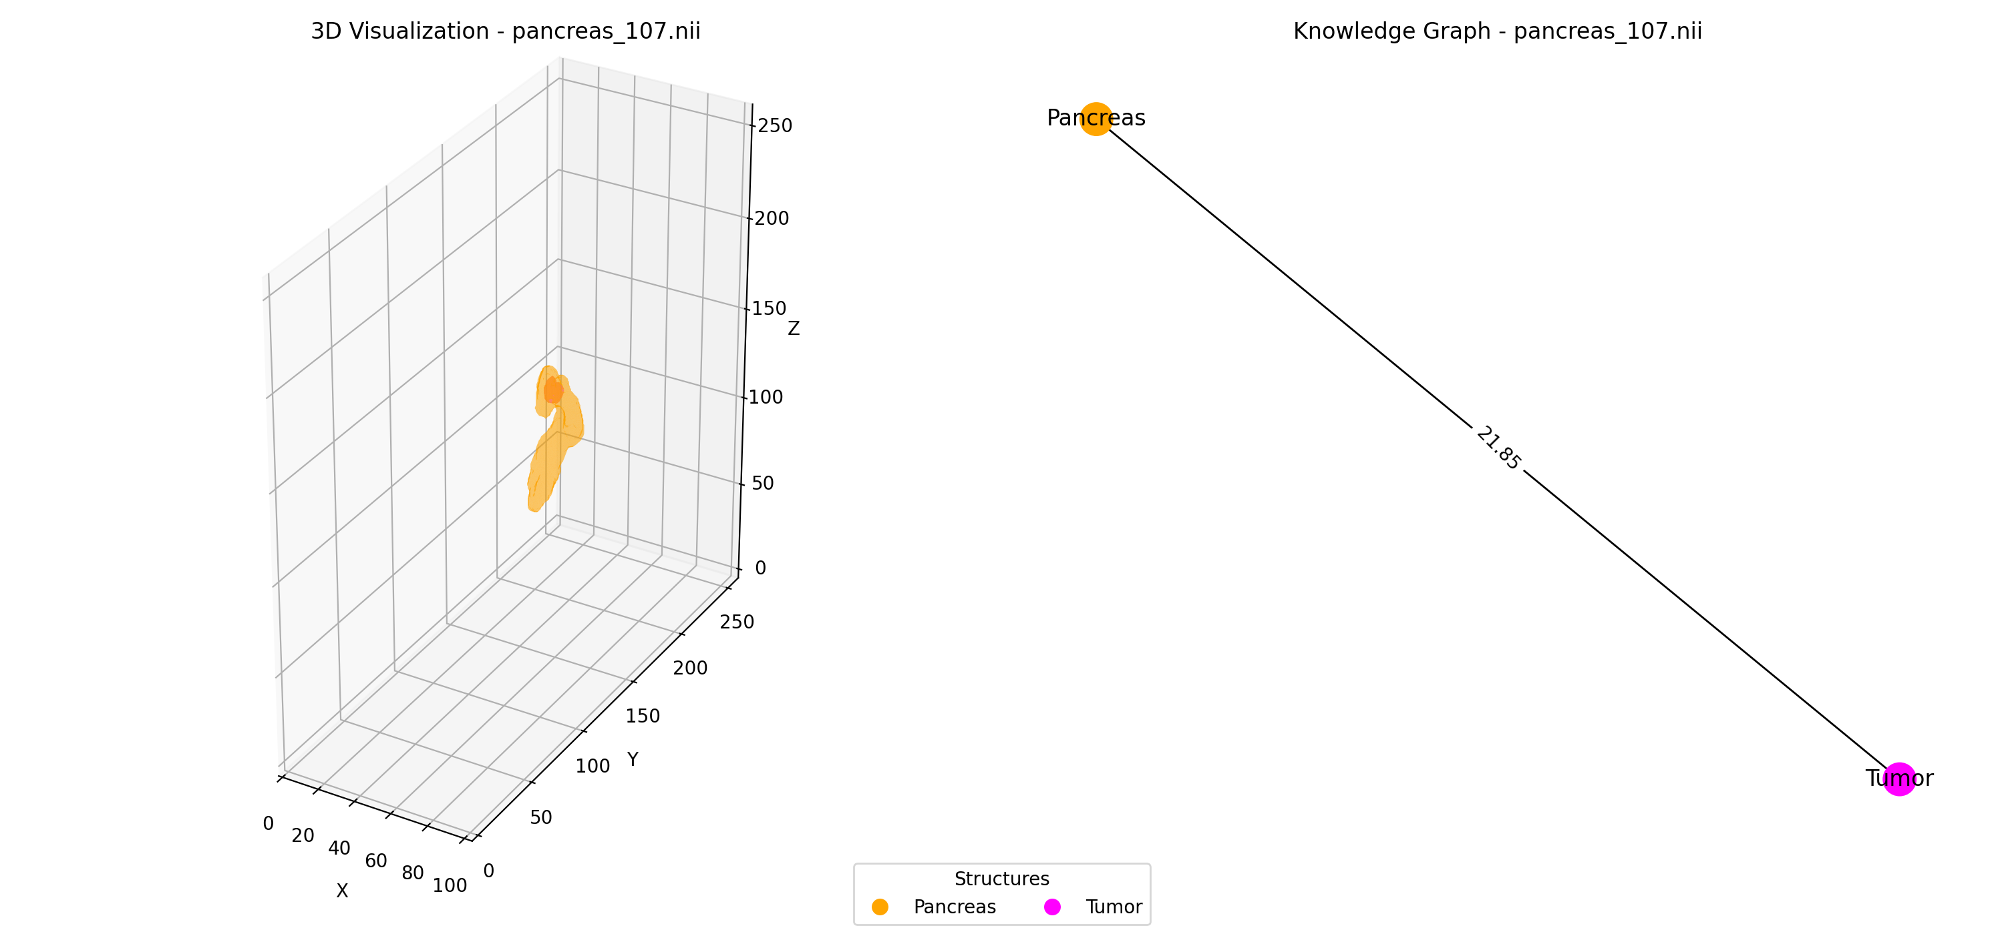
Case 2: Biggest T5 Gain — Coverage + Proximity [Pancreas] — T4 Retrieval (10/14 relevant in top-10)
Query: "Find scans with high tumor coverage AND close proximity to adjacent structures."
#1 P041 [Pancreas] (RELEVANT)
#2 P098 [Pancreas] (RELEVANT)
#3 P274 [Pancreas] (RELEVANT)
#4 P012 [Pancreas] (RELEVANT)
#5 P107 [Pancreas] (RELEVANT)
Score: 0.999 | GT: 0.582
Score: 0.978 | GT: 0.566
Score: 0.931 | GT: 0.550
Score: 0.897 | GT: 0.469
Score: 0.893 | GT: 0.512
Ranks 6-10:
*#6 P395 (score=0.882)
*#7 P125 (score=0.856)
*#8 P122 (score=0.823)
*#9 P414 (score=0.818)
*#10 P398 (score=0.806)

Slide 14
Case 2: Biggest T5 Gain — Coverage + Proximity [Pancreas] — T5 Retrieval (10/14 relevant in top-10)
Query: "Find scans with high tumor coverage AND close proximity to adjacent structures."
#1 P041 [Pancreas] (RELEVANT)
#2 P098 [Pancreas] (RELEVANT)
#3 P274 [Pancreas] (RELEVANT)
#4 P107 [Pancreas] (RELEVANT)
#5 P012 [Pancreas] (RELEVANT)
Score: 0.978 | GT: 0.582
Score: 0.960 | GT: 0.566
Score: 0.924 | GT: 0.550
Score: 0.882 | GT: 0.512
Score: 0.860 | GT: 0.469
Ranks 6-10:
*#6 P125 (score=0.857)
*#7 P395 (score=0.850)
*#8 P122 (score=0.839)
*#9 P398 (score=0.812)
*#10 P414 (score=0.810)

Slide 15
Case 3: Progressive T1<T3<T4<T5 [Pancreas]
Natural Language:
"Find scans with high coverage AND complex organ topology AND close proximity."
Dataset: Pancreas
Constraints: coverage_containment_proximity
Cardinality: 3
Min Tier: T5
T5 Weight: 63.3%
Relevant: 10/57
Top-10 Relevant Retrieval Across Tiers:
T1: 2/10
T2: 1/10
T3: 8/10
T4: 8/10
T5: 9/10
Key Insight: Clearest progressive improvement: 2→1→8→8→9. Each modality from T3 onward adds value; only T5 reaches 9/10.

Slide 16
Case 3: Progressive T1<T3<T4<T5 [Pancreas] — T1 Retrieval (2/10 relevant in top-10)
Query: "Find scans with high coverage AND complex organ topology AND close proximity."
#1 P094 [Pancreas] (irrelevant)
#2 P088 [Pancreas] (irrelevant)
#3 P414 [Pancreas] (RELEVANT)
#4 P041 [Pancreas] (RELEVANT)
#5 P391 [Pancreas] (irrelevant)
Score: 0.971 | GT: 0.043
Score: 0.956 | GT: 0.136
Score: 0.863 | GT: 0.296
Score: 0.855 | GT: 0.344
Score: 0.846 | GT: 0.154
Ranks 6-10:
#6 P012 (score=0.799)
#7 P071 (score=0.676)
#8 P131 (score=0.657)
#9 P086 (score=0.606)
#10 P405 (score=0.536)

Slide 17
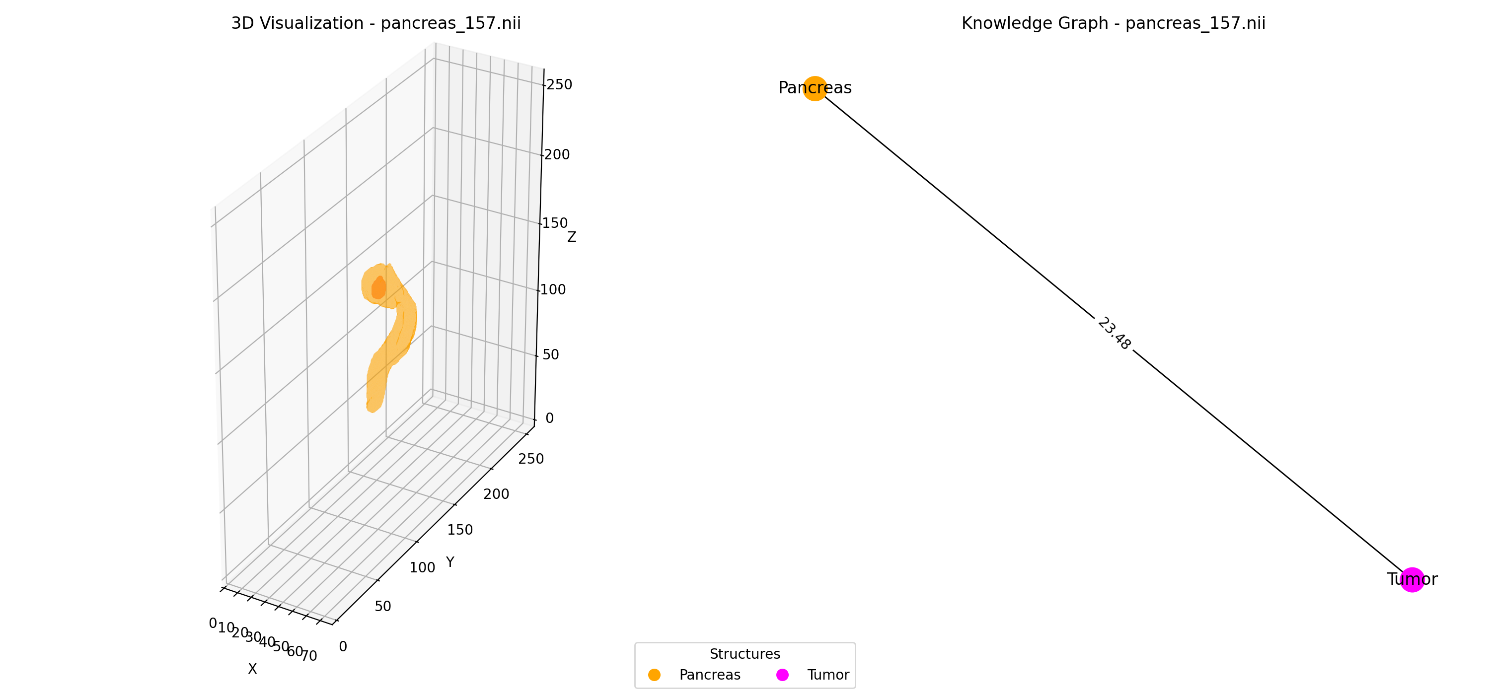
Case 3: Progressive T1<T3<T4<T5 [Pancreas] — T2 Retrieval (1/10 relevant in top-10)
Query: "Find scans with high coverage AND complex organ topology AND close proximity."
#1 P074 [Pancreas] (irrelevant)
#2 P398 [Pancreas] (RELEVANT)
#3 P071 [Pancreas] (irrelevant)
#4 P310 [Pancreas] (irrelevant)
#5 P157 [Pancreas] (irrelevant)
Score: 0.949 | GT: 0.126
Score: 0.891 | GT: 0.280
Score: 0.879 | GT: 0.183
Score: 0.879 | GT: 0.167
Score: 0.841 | GT: 0.117
Ranks 6-10:
#6 P350 (score=0.754)
#7 P391 (score=0.754)
#8 P231 (score=0.725)
#9 P256 (score=0.716)
#10 P094 (score=0.701)

Slide 18
Case 3: Progressive T1<T3<T4<T5 [Pancreas] — T3 Retrieval (8/10 relevant in top-10)
Query: "Find scans with high coverage AND complex organ topology AND close proximity."
#1 P041 [Pancreas] (RELEVANT)
#2 P098 [Pancreas] (RELEVANT)
#3 P012 [Pancreas] (irrelevant)
#4 P274 [Pancreas] (RELEVANT)
#5 P395 [Pancreas] (RELEVANT)
Score: 1.000 | GT: 0.344
Score: 0.969 | GT: 0.335
Score: 0.912 | GT: 0.277
Score: 0.909 | GT: 0.325
Score: 0.904 | GT: 0.291
Ranks 6-10:
*#6 P398 (score=0.874)
*#7 P107 (score=0.871)
*#8 P122 (score=0.869)
#9 P278 (score=0.837)
*#10 P414 (score=0.829)

Slide 19
Case 3: Progressive T1<T3<T4<T5 [Pancreas] — T4 Retrieval (8/10 relevant in top-10)
Query: "Find scans with high coverage AND complex organ topology AND close proximity."
#1 P041 [Pancreas] (RELEVANT)
#2 P098 [Pancreas] (RELEVANT)
#3 P274 [Pancreas] (RELEVANT)
#4 P107 [Pancreas] (RELEVANT)
#5 P395 [Pancreas] (RELEVANT)
Score: 1.000 | GT: 0.344
Score: 0.973 | GT: 0.335
Score: 0.940 | GT: 0.325
Score: 0.908 | GT: 0.303
Score: 0.901 | GT: 0.291
Ranks 6-10:
#6 P012 (score=0.886)
*#7 P125 (score=0.863)
*#8 P122 (score=0.838)
*#9 P414 (score=0.838)
#10 P278 (score=0.822)

Slide 20
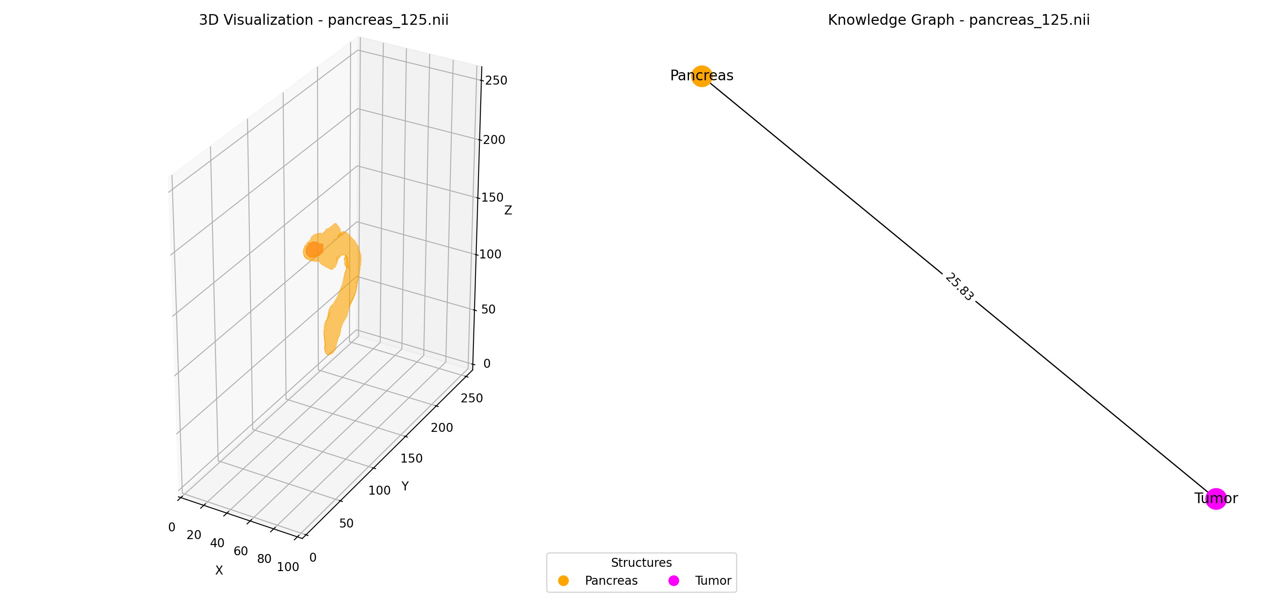
Case 3: Progressive T1<T3<T4<T5 [Pancreas] — T5 Retrieval (9/10 relevant in top-10)
Query: "Find scans with high coverage AND complex organ topology AND close proximity."
#1 P041 [Pancreas] (RELEVANT)
#2 P098 [Pancreas] (RELEVANT)
#3 P274 [Pancreas] (RELEVANT)
#4 P107 [Pancreas] (RELEVANT)
#5 P125 [Pancreas] (RELEVANT)
Score: 0.962 | GT: 0.344
Score: 0.945 | GT: 0.335
Score: 0.918 | GT: 0.325
Score: 0.872 | GT: 0.303
Score: 0.844 | GT: 0.301
Ranks 6-10:
*#6 P395 (score=0.843)
#7 P012 (score=0.829)
*#8 P122 (score=0.828)
*#9 P414 (score=0.825)
*#10 P398 (score=0.802)

Slide 21
Case 4: Massive T3 CLIP Jump [FLARE]
Natural Language:
"Find scans with high tumor volume AND complex organ topology."
Dataset: FLARE
Constraints: volume_containment
Cardinality: 2
Min Tier: T5
T5 Weight: 61.1%
Relevant: 20/85
Top-10 Relevant Retrieval Across Tiers:
T1: 3/20
T2: 3/20
T3: 10/20
T4: 10/20
T5: 10/20
Key Insight: CLIP completely reshuffles top-10 at T3 (3→10 relevant). All 7 irrelevant scans removed in one tier step.

Slide 22
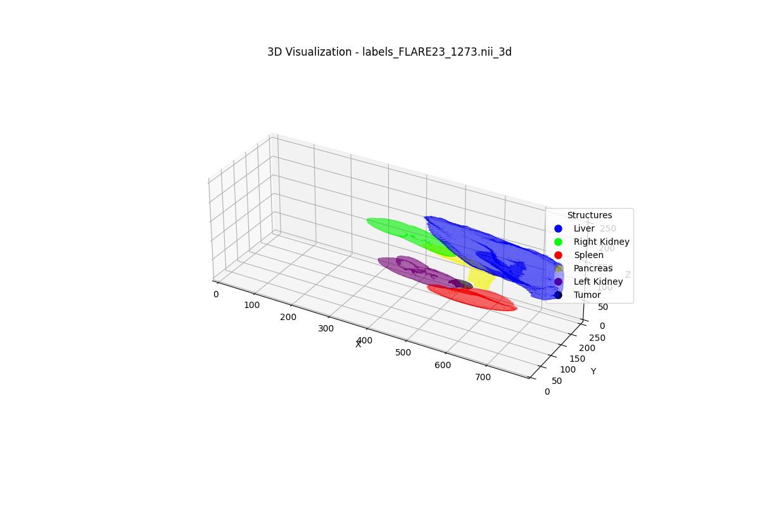
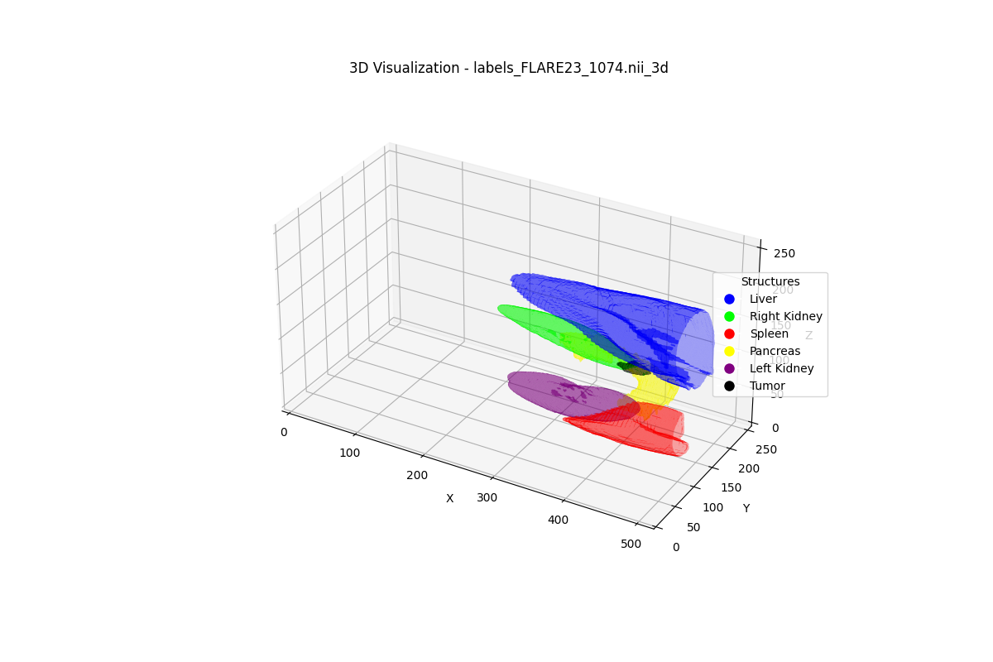
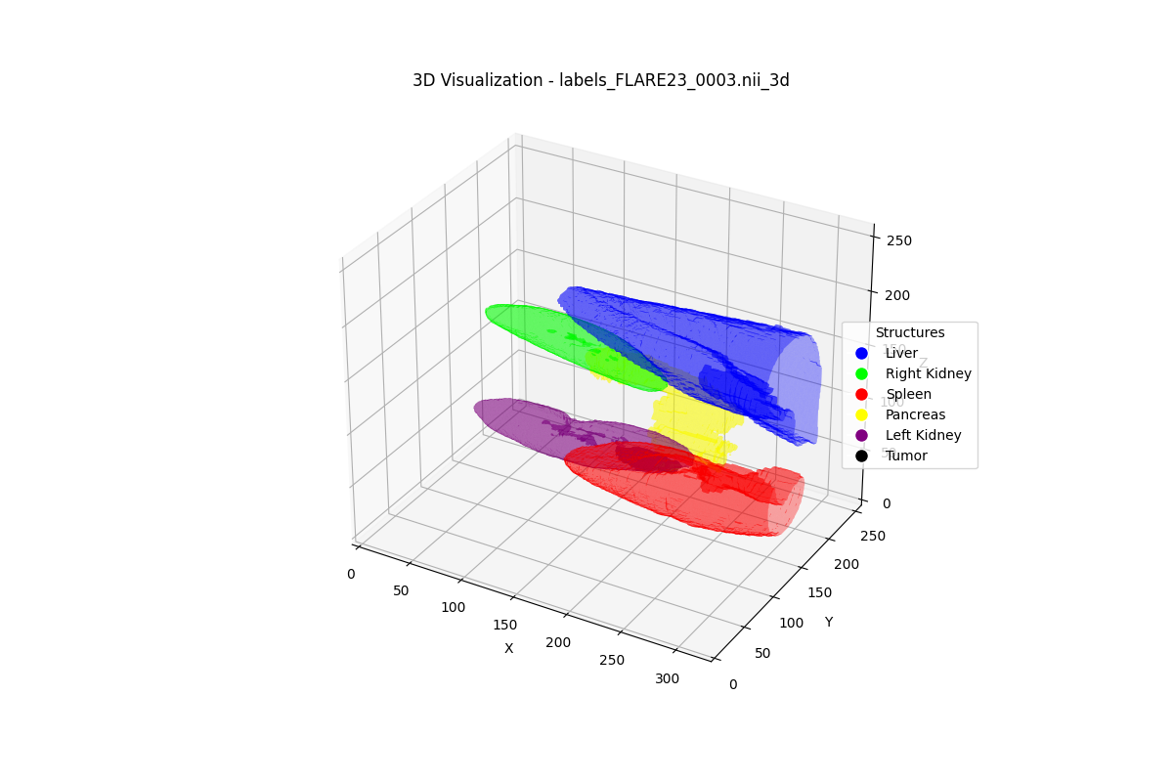
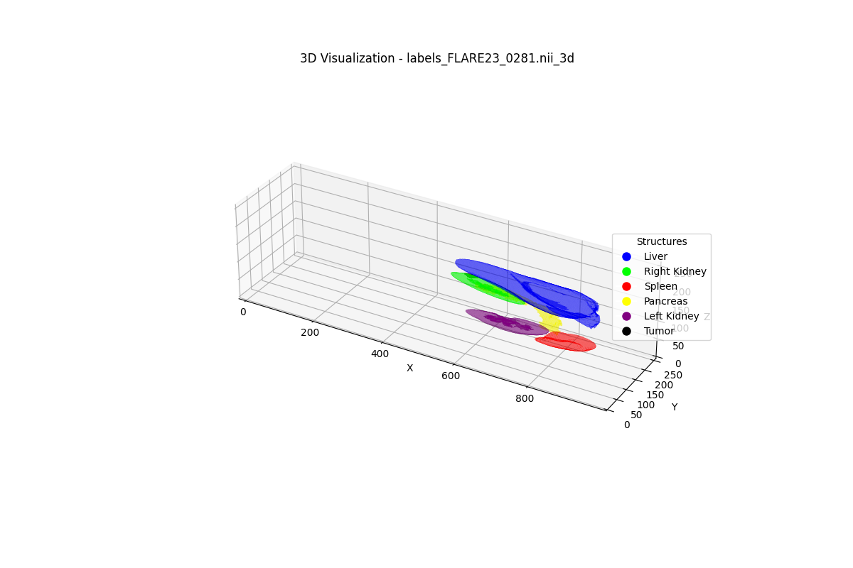
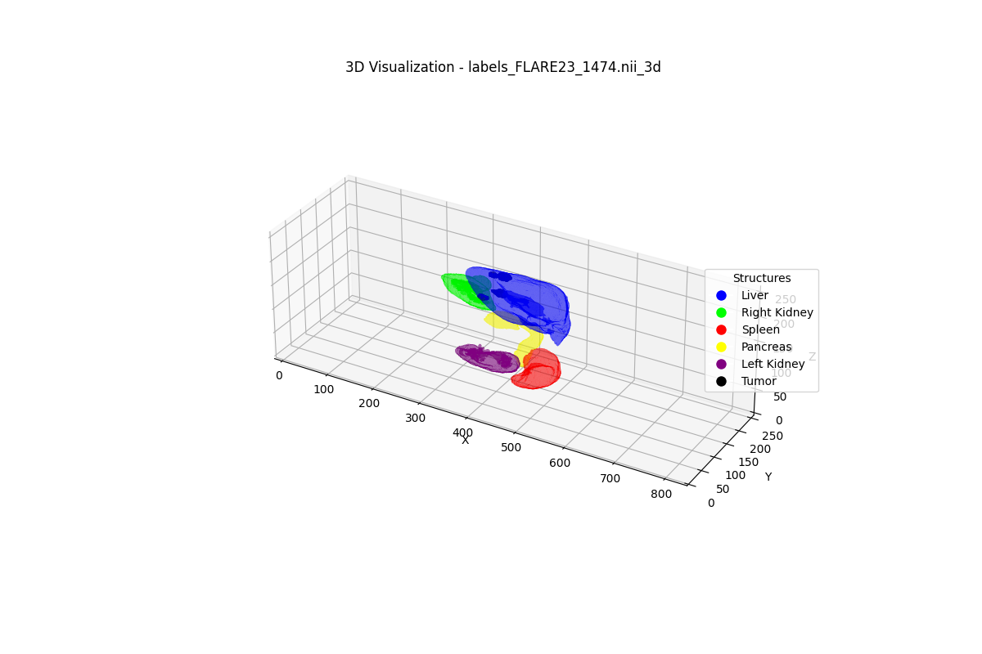
Case 4: Massive T3 CLIP Jump [FLARE] — T1 Retrieval (3/20 relevant in top-10)
Query: "Find scans with high tumor volume AND complex organ topology."
#1 F1273 [FLARE] (irrelevant)
#2 F1074 [FLARE] (RELEVANT)
#3 F0003 [FLARE] (RELEVANT)
#4 F0281 [FLARE] (irrelevant)
#5 F1474 [FLARE] (irrelevant)
Score: 1.000 | GT: 0.289
Score: 0.926 | GT: 0.349
Score: 0.921 | GT: 0.327
Score: 0.904 | GT: 0.322
Score: 0.859 | GT: 0.223
Ranks 6-10:
#6 F0487 (score=0.786)
#7 F1495 (score=0.767)
#8 F2017 (score=0.763)
#9 F1991 (score=0.761)
*#10 F1654 (score=0.758)

Slide 23
Case 4: Massive T3 CLIP Jump [FLARE] — T2 Retrieval (3/20 relevant in top-10)
Query: "Find scans with high tumor volume AND complex organ topology."
#1 F1273 [FLARE] (irrelevant)
#2 F1074 [FLARE] (RELEVANT)
#3 F0003 [FLARE] (RELEVANT)
#4 F1474 [FLARE] (irrelevant)
#5 F0281 [FLARE] (irrelevant)
Score: 0.967 | GT: 0.289
Score: 0.947 | GT: 0.349
Score: 0.929 | GT: 0.327
Score: 0.874 | GT: 0.223
Score: 0.852 | GT: 0.322
Ranks 6-10:
#6 F1495 (score=0.808)
#7 F1056 (score=0.773)
#8 F0802 (score=0.770)
#9 F1991 (score=0.763)
*#10 F1107 (score=0.762)

Slide 24
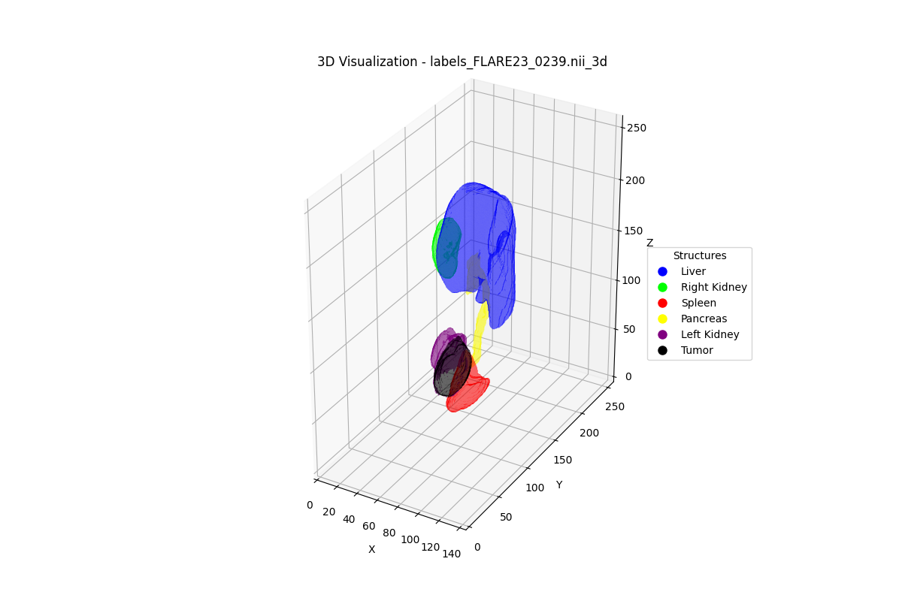
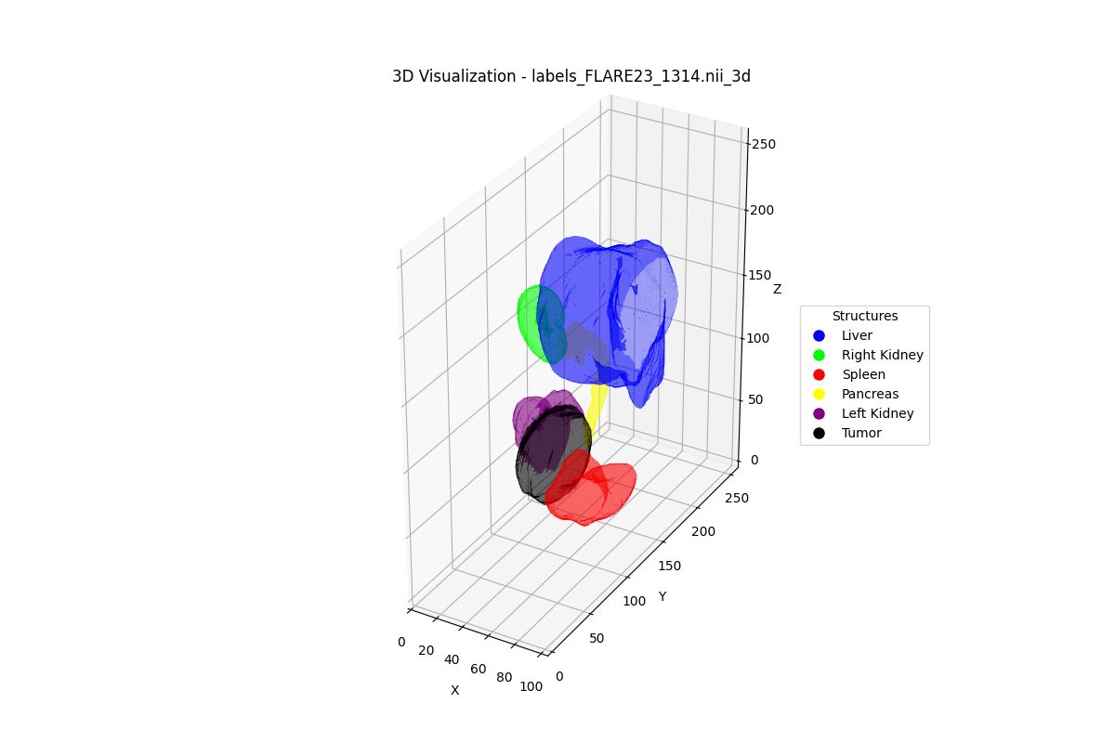
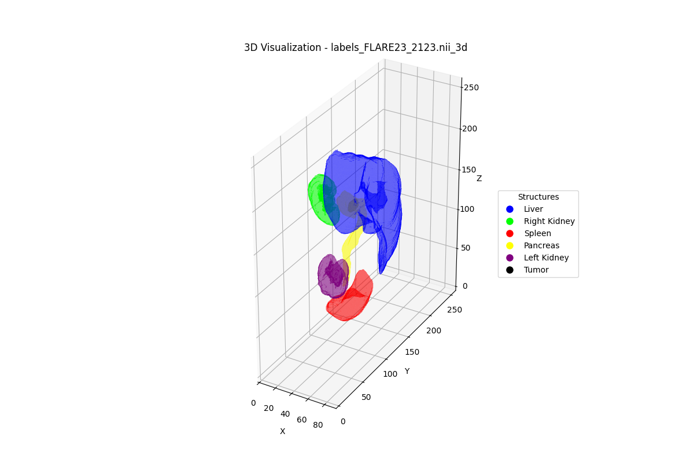
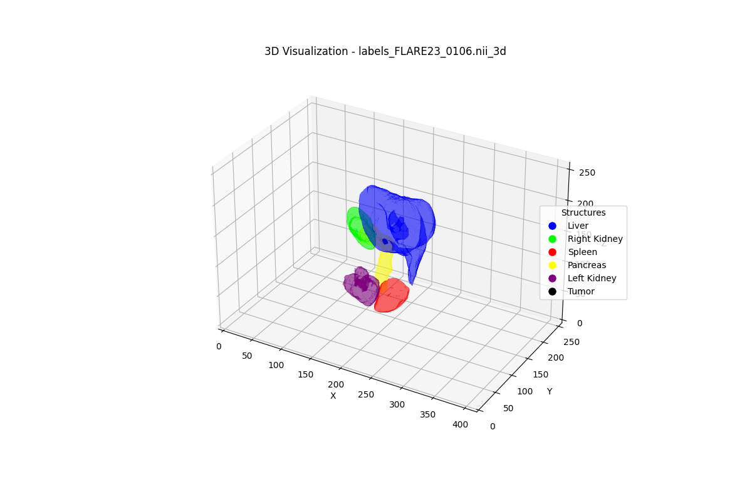
Case 4: Massive T3 CLIP Jump [FLARE] — T3 Retrieval (10/20 relevant in top-10)
Query: "Find scans with high tumor volume AND complex organ topology."
#1 F0239 [FLARE] (RELEVANT)
#2 F1314 [FLARE] (RELEVANT)
#3 F1074 [FLARE] (RELEVANT)
#4 F2123 [FLARE] (RELEVANT)
#5 F0106 [FLARE] (RELEVANT)
Score: 0.996 | GT: 0.370
Score: 0.991 | GT: 0.381
Score: 0.974 | GT: 0.349
Score: 0.973 | GT: 0.374
Score: 0.970 | GT: 0.353
Ranks 6-10:
*#6 F1115 (score=0.966)
*#7 F0128 (score=0.965)
*#8 F1225 (score=0.961)
*#9 F0805 (score=0.952)
*#10 F1107 (score=0.916)

Slide 25
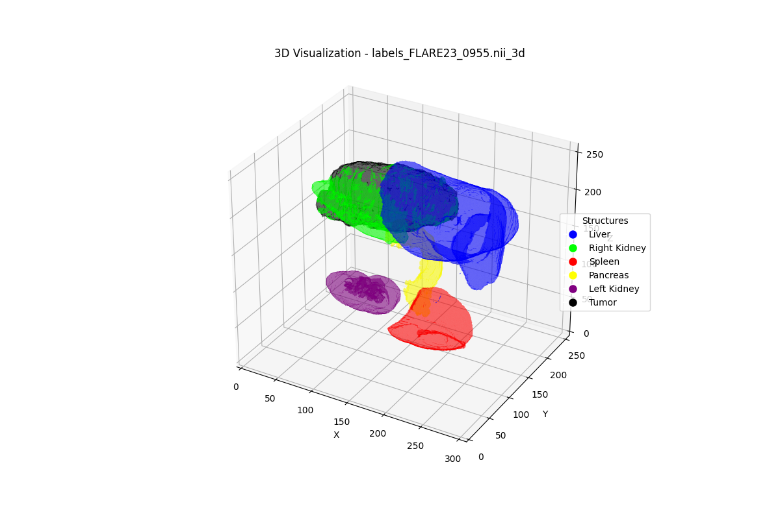
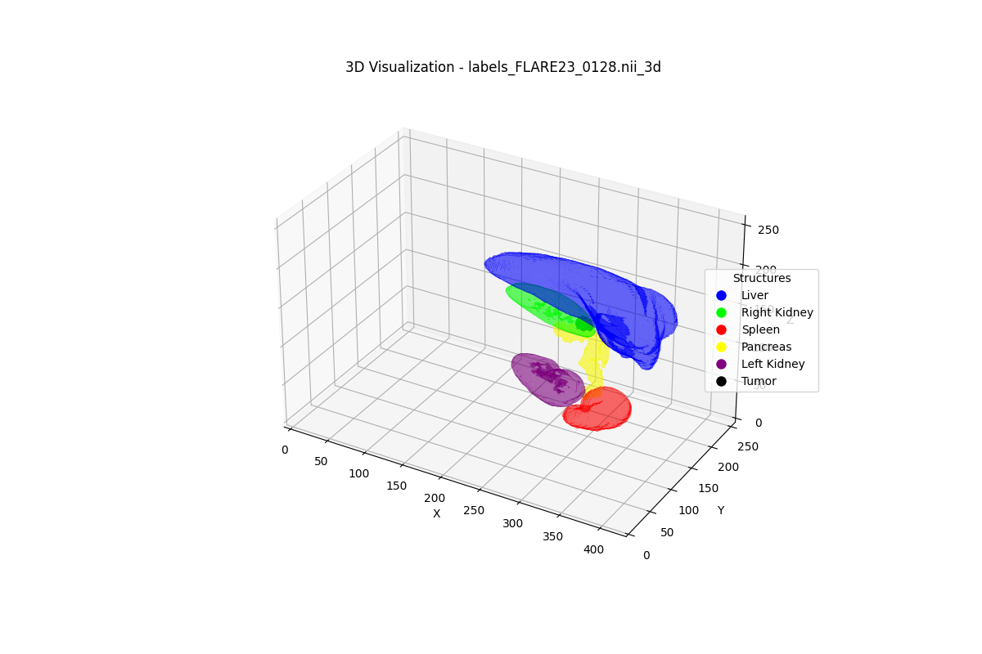
Case 4: Massive T3 CLIP Jump [FLARE] — T4 Retrieval (10/20 relevant in top-10)
Query: "Find scans with high tumor volume AND complex organ topology."
#1 F0955 [FLARE] (RELEVANT)
#2 F0239 [FLARE] (RELEVANT)
#3 F1314 [FLARE] (RELEVANT)
#4 F0128 [FLARE] (RELEVANT)
#5 F0106 [FLARE] (RELEVANT)
Score: 0.919 | GT: 0.376
Score: 0.886 | GT: 0.370
Score: 0.884 | GT: 0.381
Score: 0.874 | GT: 0.354
Score: 0.871 | GT: 0.353
Ranks 6-10:
*#6 F2123 (score=0.864)
*#7 F1074 (score=0.855)
*#8 F1225 (score=0.852)
*#9 F1115 (score=0.831)
*#10 F0805 (score=0.826)

Slide 26
Case 4: Massive T3 CLIP Jump [FLARE] — T5 Retrieval (10/20 relevant in top-10)
Query: "Find scans with high tumor volume AND complex organ topology."
#1 F0955 [FLARE] (RELEVANT)
#2 F1314 [FLARE] (RELEVANT)
#3 F1115 [FLARE] (RELEVANT)
#4 F0239 [FLARE] (RELEVANT)
#5 F2123 [FLARE] (RELEVANT)
Score: 0.936 | GT: 0.376
Score: 0.908 | GT: 0.381
Score: 0.899 | GT: 0.376
Score: 0.890 | GT: 0.370
Score: 0.880 | GT: 0.374
Ranks 6-10:
*#6 F1225 (score=0.871)
*#7 F1453 (score=0.859)
*#8 F0128 (score=0.855)
*#9 F1074 (score=0.854)
*#10 F1107 (score=0.849)

Slide 27
Case 5: Only T5 Succeeds [LiTS]
Natural Language:
"Find scans with high volume AND close proximity AND complex topology."
Dataset: LiTS
Constraints: volume_proximity_containment
Cardinality: 3
Min Tier: T5
T5 Weight: 61.7%
Relevant: 6/24
Top-10 Relevant Retrieval Across Tiers:
T1: 3/6
T2: 2/6
T3: 3/6
T4: 3/6
T5: 6/6
Key Insight: T1-T4 plateau at 2-3/6. Only VKG reasoning at T5 achieves perfect 6/6 retrieval — 3 new scans enter top-10.

Slide 28
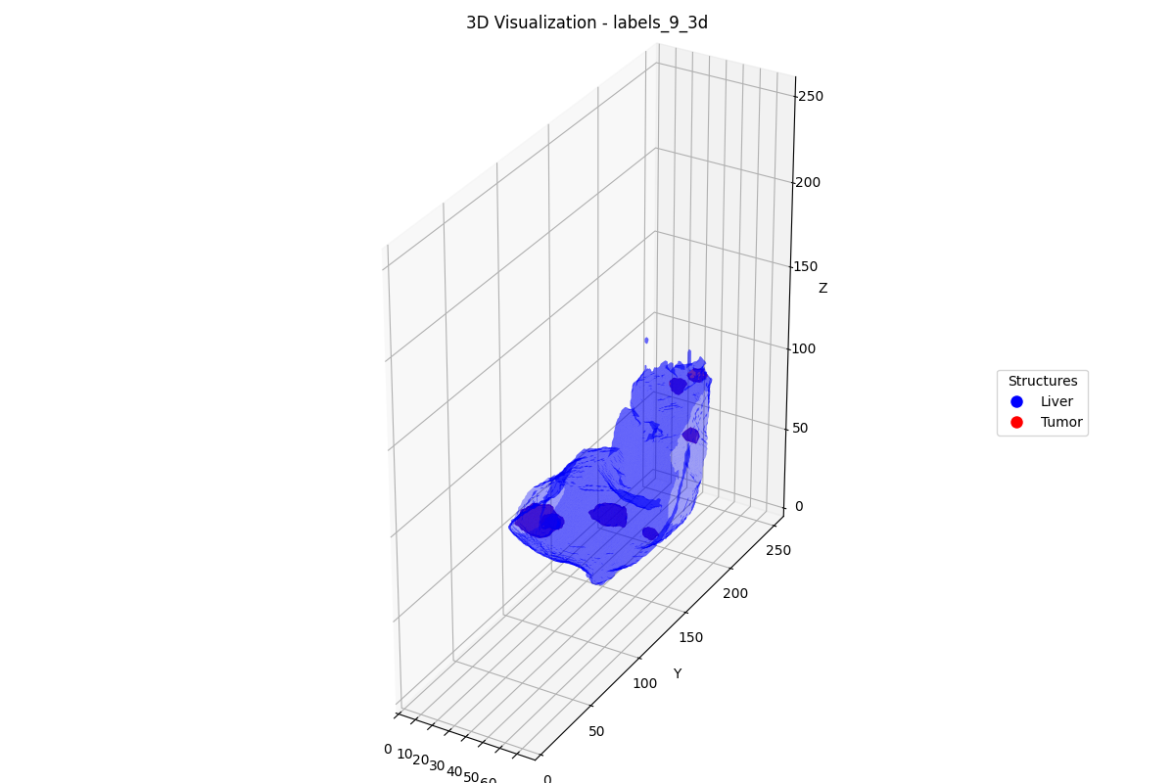

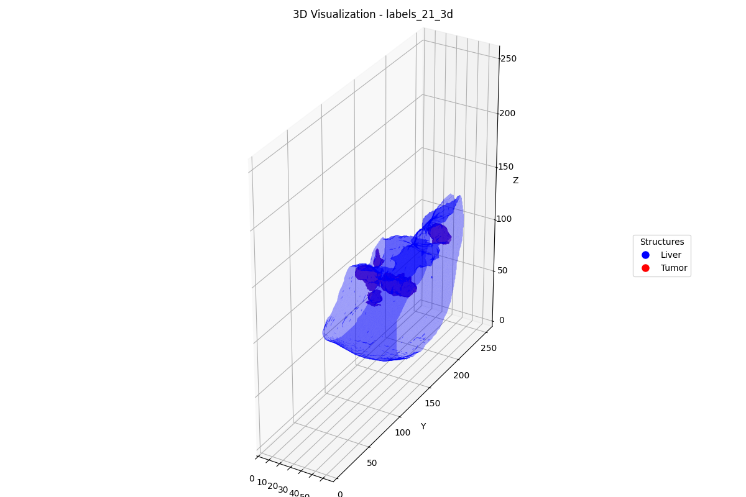
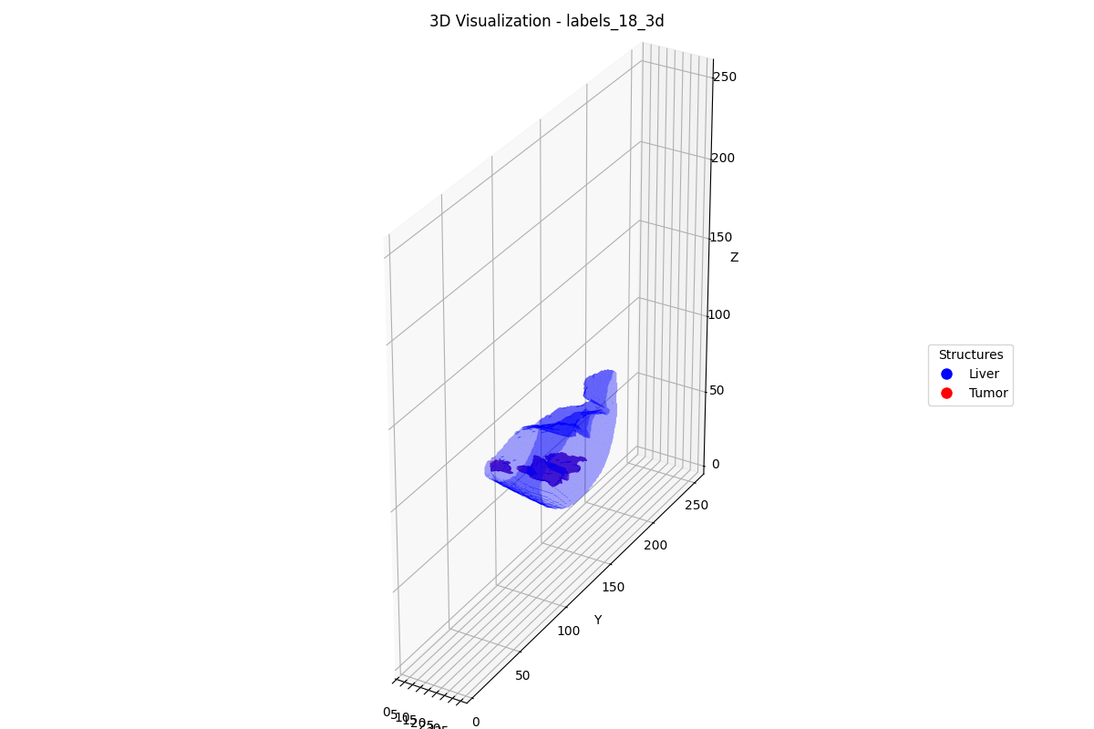
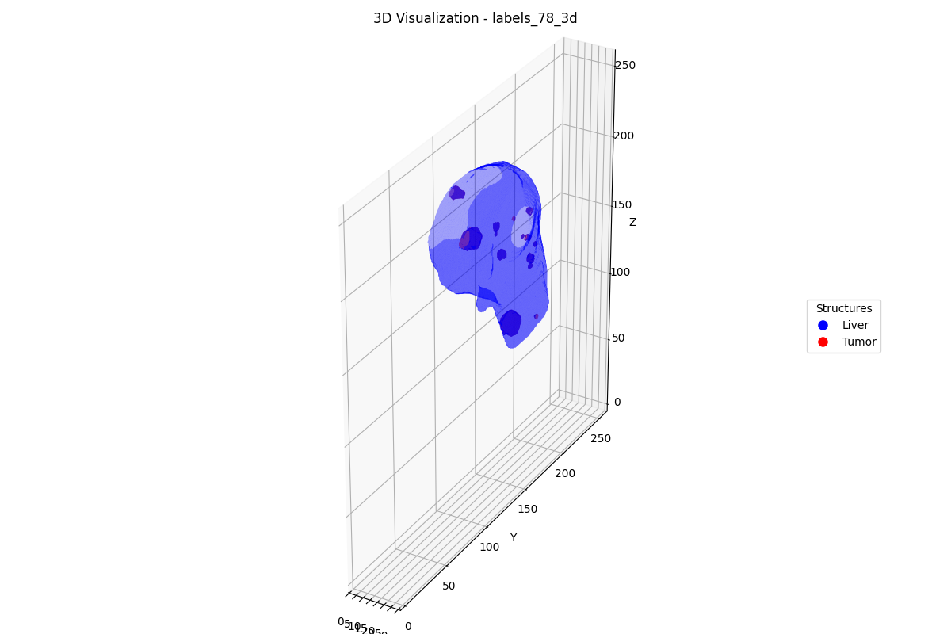
Case 5: Only T5 Succeeds [LiTS] — T1 Retrieval (3/6 relevant in top-10)
Query: "Find scans with high volume AND close proximity AND complex topology."
#1 9 [LiTS] (irrelevant)
#2 8 [LiTS] (irrelevant)
#3 21 [LiTS] (irrelevant)
#4 18 [LiTS] (irrelevant)
#5 78 [LiTS] (irrelevant)
Score: 0.873 | GT: 0.371
Score: 0.863 | GT: 0.317
Score: 0.862 | GT: 0.297
Score: 0.861 | GT: 0.278
Score: 0.852 | GT: 0.368
Ranks 6-10:
#6 79 (score=0.846)
*#7 103 (score=0.836)
#8 1 (score=0.829)
*#9 113 (score=0.826)
*#10 124 (score=0.823)

Slide 29
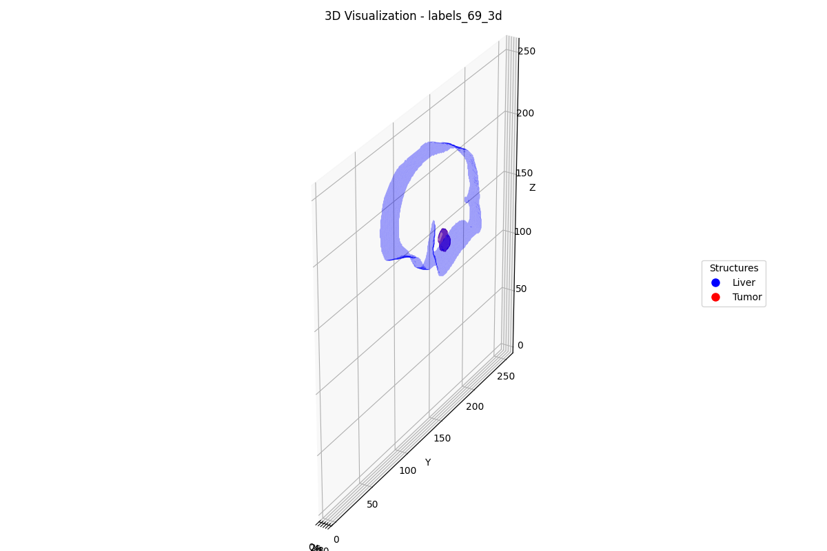
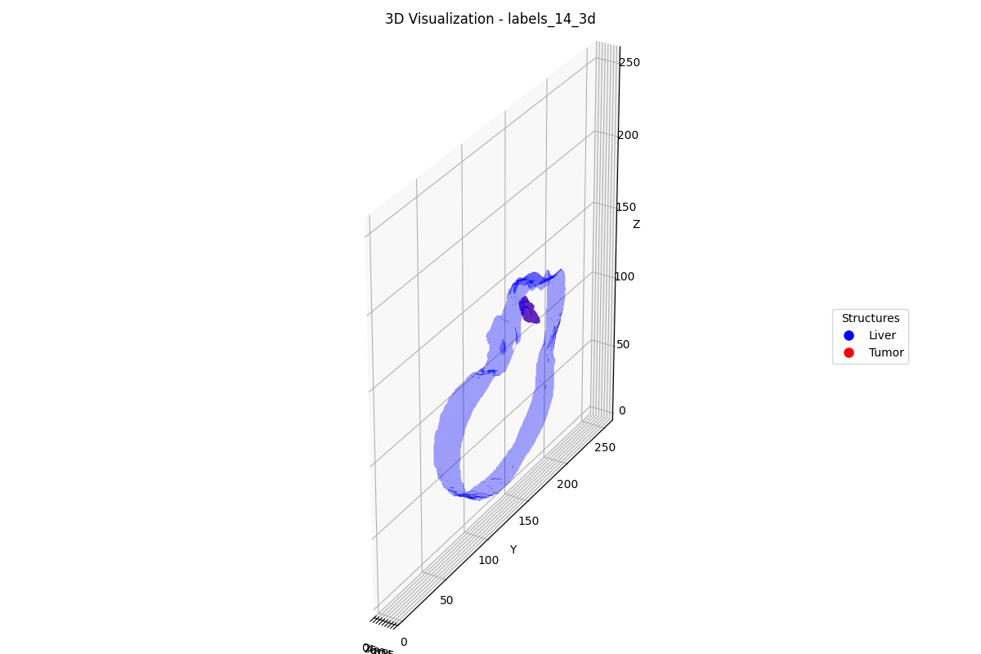
Case 5: Only T5 Succeeds [LiTS] — T2 Retrieval (2/6 relevant in top-10)
Query: "Find scans with high volume AND close proximity AND complex topology."
#1 8 [LiTS] (irrelevant)
#2 21 [LiTS] (irrelevant)
#3 69 [LiTS] (irrelevant)
#4 14 [LiTS] (irrelevant)
#5 9 [LiTS] (irrelevant)
Score: 0.968 | GT: 0.317
Score: 0.958 | GT: 0.297
Score: 0.915 | GT: 0.326
Score: 0.852 | GT: 0.351
Score: 0.817 | GT: 0.371
Ranks 6-10:
*#6 113 (score=0.816)
#7 0 (score=0.804)
#8 1 (score=0.804)
#9 18 (score=0.785)
*#10 58 (score=0.783)

Slide 30
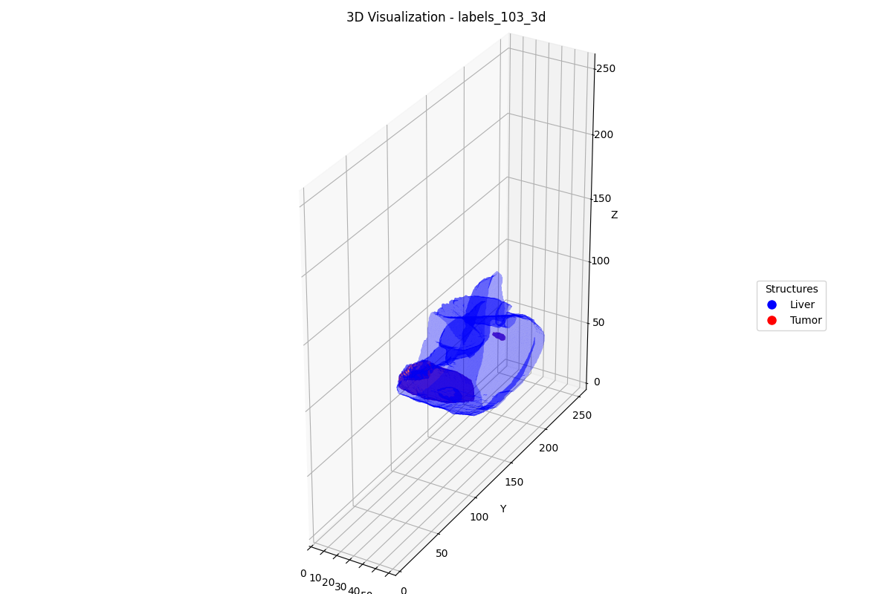
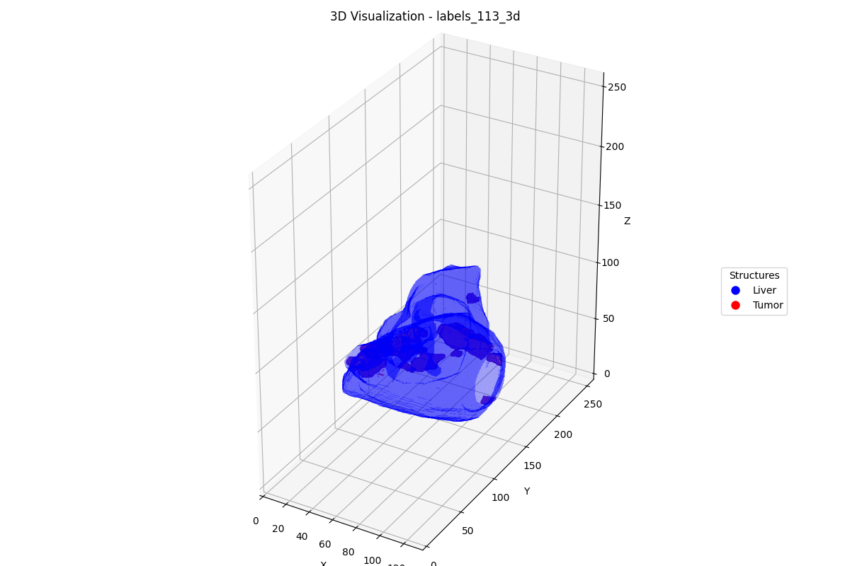
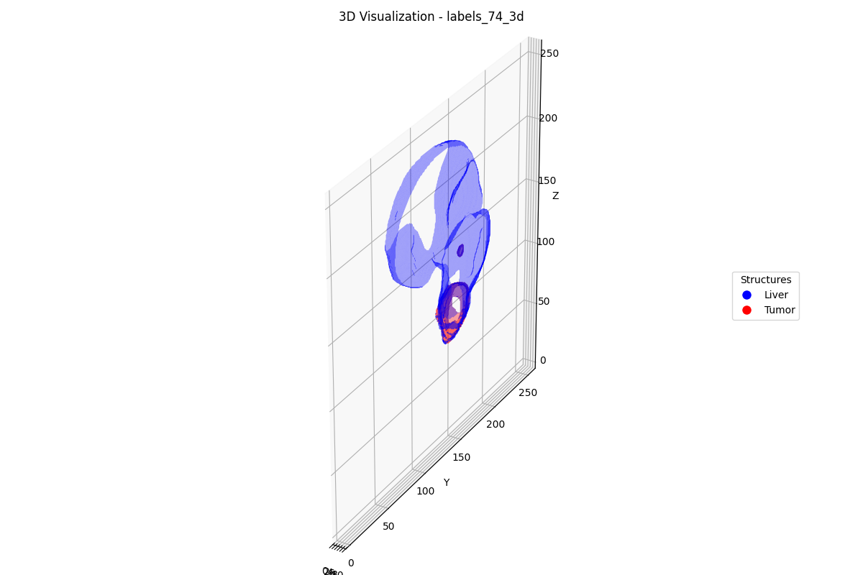
Case 5: Only T5 Succeeds [LiTS] — T3 Retrieval (3/6 relevant in top-10)
Query: "Find scans with high volume AND close proximity AND complex topology."
#1 103 [LiTS] (RELEVANT)
#2 113 [LiTS] (RELEVANT)
#3 74 [LiTS] (irrelevant)
#4 9 [LiTS] (irrelevant)
#5 78 [LiTS] (irrelevant)
Score: 0.988 | GT: 0.369
Score: 0.986 | GT: 0.383
Score: 0.960 | GT: 0.359
Score: 0.952 | GT: 0.371
Score: 0.950 | GT: 0.368
Ranks 6-10:
*#6 58 (score=0.944)
#7 71 (score=0.918)
#8 14 (score=0.907)
#9 69 (score=0.897)
#10 21 (score=0.892)

Slide 31
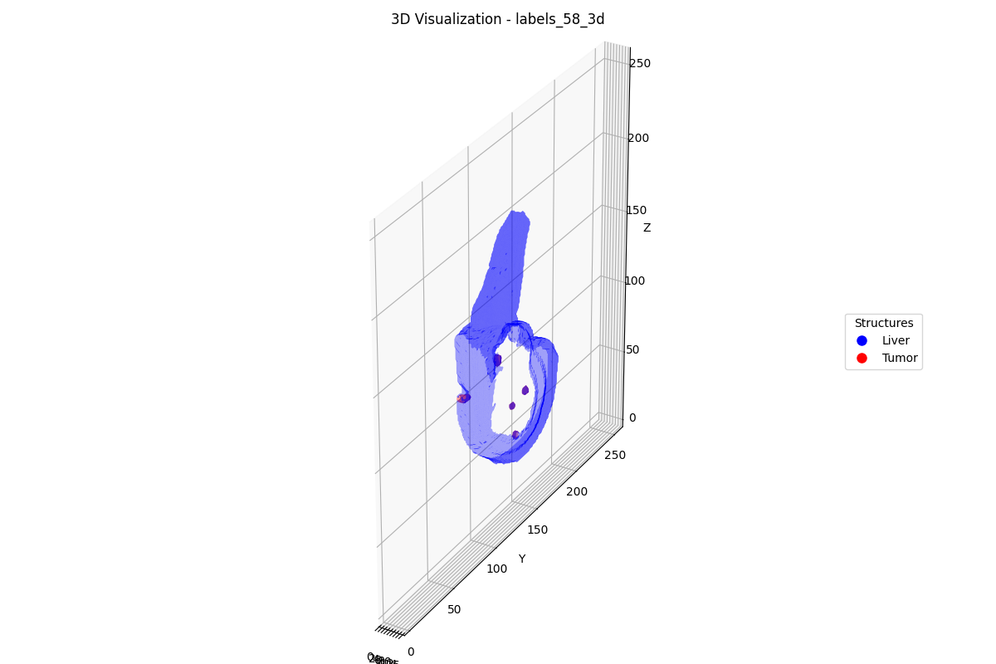
Case 5: Only T5 Succeeds [LiTS] — T4 Retrieval (3/6 relevant in top-10)
Query: "Find scans with high volume AND close proximity AND complex topology."
#1 103 [LiTS] (RELEVANT)
#2 113 [LiTS] (RELEVANT)
#3 74 [LiTS] (irrelevant)
#4 58 [LiTS] (RELEVANT)
#5 9 [LiTS] (irrelevant)
Score: 0.983 | GT: 0.369
Score: 0.981 | GT: 0.383
Score: 0.953 | GT: 0.359
Score: 0.950 | GT: 0.373
Score: 0.940 | GT: 0.371
Ranks 6-10:
#6 78 (score=0.933)
#7 71 (score=0.920)
#8 14 (score=0.899)
#9 21 (score=0.887)
#10 69 (score=0.886)

Slide 32
Case 5: Only T5 Succeeds [LiTS] — T5 Retrieval (6/6 relevant in top-10)
Query: "Find scans with high volume AND close proximity AND complex topology."
#1 113 [LiTS] (RELEVANT)
#2 58 [LiTS] (RELEVANT)
#3 103 [LiTS] (RELEVANT)
#4 9 [LiTS] (irrelevant)
#5 78 [LiTS] (irrelevant)
Score: 0.960 | GT: 0.383
Score: 0.943 | GT: 0.373
Score: 0.939 | GT: 0.369
Score: 0.925 | GT: 0.371
Score: 0.916 | GT: 0.368
Ranks 6-10:
#6 74 (score=0.905)
#7 71 (score=0.905)
*#8 124 (score=0.882)
*#9 97 (score=0.877)
*#10 118 (score=0.865)

Slide 33
Summary: Tier Progression Across 5 Cases
Case
Dataset
Query
Constraints
Min Tier
T1
T2
T3
T4
T5
Key Insight
1
FLARE
Q010
multiplicity
T1
10/22
10/22
10/22
10/22
10/22
T1 sufficient — all tiers retrieve 10/10 relevant in top-10. Multiplicity is ful...
2
Pancreas
Q028
coverage_proximity
T5
4/14
2/14
10/14
10/14
10/14
Biggest gain across all datasets (4→10 relevant). CLIP is the key unlock: 8 new ...
3
Pancreas
Q009
coverage_containment_proximity
T5
2/10
1/10
8/10
8/10
9/10
Clearest progressive improvement: 2→1→8→8→9. Each modality from T3 onward adds v...
4
FLARE
Q138
volume_containment
T5
3/20
3/20
10/20
10/20
10/20
CLIP completely reshuffles top-10 at T3 (3→10 relevant). All 7 irrelevant scans ...
5
LiTS
Q059
volume_proximity_containment
T5
3/6
2/6
3/6
3/6
6/6
T1-T4 plateau at 2-3/6. Only VKG reasoning at T5 achieves perfect 6/6 retrieval ...

Slide 34
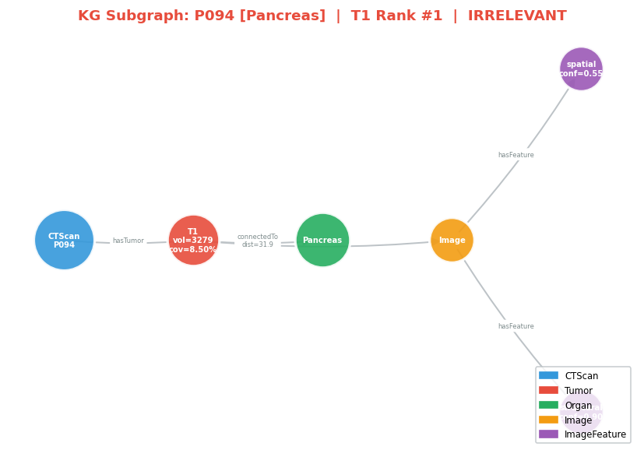

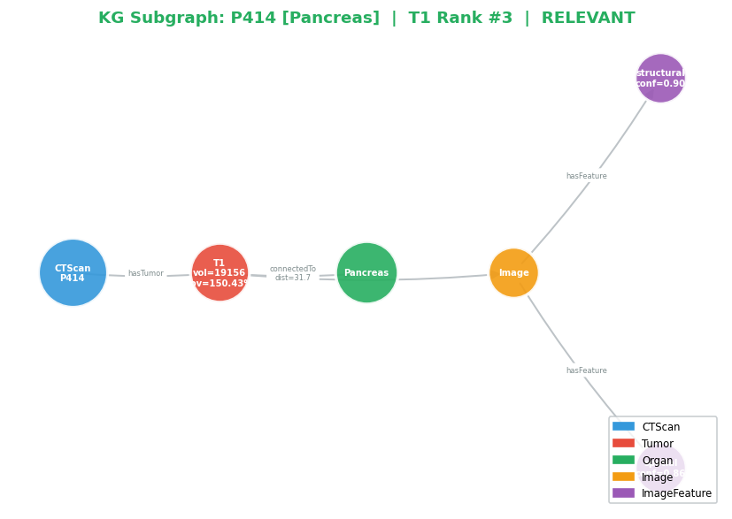
Case 2: Coverage + Proximity [Pancreas] — T1 KG Subgraphs (4/14 relevant in top-10)
Query: "Find scans with high tumor coverage AND close proximity to adjacent structures." | T1 retrieves mostly irrelevant scans; T3/T5 find the right ones.
#1 P094 [Pancreas] (irrelevant)
#2 P088 [Pancreas] (irrelevant)
#3 P414 [Pancreas] (RELEVANT)
Score: 0.978
Score: 0.956
Score: 0.928
T1 uses only tabular features (volume, coverage, distance). Subgraphs show that top-ranked scans may have simple KG structure — fewer connections, fewer organs, simpler topology.

Slide 35



Case 2: Coverage + Proximity [Pancreas] — T5 KG Subgraphs (10/14 relevant in top-10)
Query: "Find scans with high tumor coverage AND close proximity to adjacent structures." | T1 retrieves mostly irrelevant scans; T3/T5 find the right ones.
#1 P041 [Pancreas] (RELEVANT)
#2 P098 [Pancreas] (RELEVANT)
#3 P274 [Pancreas] (RELEVANT)
Score: 0.978
Score: 0.960
Score: 0.924
T5 adds VKG reasoning features (path completeness, topology diversity, adjacency density). Subgraphs show that correctly retrieved scans tend to have richer KG structure — multiple organs, more tumors, complex paths.

Slide 36
Case 2: Coverage + Proximity [Pancreas] — T1 vs T5: Top-1 Retrieved Scan Comparison
Query: "Find scans with high tumor coverage AND close proximity to adjacent structures."
T1 Top-1: #1 P094 [Pancreas] (irrelevant) | Score: 0.978
T5 Top-1: #1 P041 [Pancreas] (RELEVANT) | Score: 0.978
→

Slide 37
Case 3: Coverage + Containment + Proximity [Pancreas] — T1 KG Subgraphs (2/10 relevant in top-10)
Query: "Find scans with high coverage AND complex topology AND close proximity." | Progressive improvement from 2/10 to 9/10.
#1 P094 [Pancreas] (irrelevant)
#2 P088 [Pancreas] (irrelevant)
#3 P414 [Pancreas] (RELEVANT)
Score: 0.971
Score: 0.956
Score: 0.863
T1 uses only tabular features (volume, coverage, distance). Subgraphs show that top-ranked scans may have simple KG structure — fewer connections, fewer organs, simpler topology.

Slide 38
Case 3: Coverage + Containment + Proximity [Pancreas] — T5 KG Subgraphs (9/10 relevant in top-10)
Query: "Find scans with high coverage AND complex topology AND close proximity." | Progressive improvement from 2/10 to 9/10.
#1 P041 [Pancreas] (RELEVANT)
#2 P098 [Pancreas] (RELEVANT)
#3 P274 [Pancreas] (RELEVANT)
Score: 0.962
Score: 0.945
Score: 0.918
T5 adds VKG reasoning features (path completeness, topology diversity, adjacency density). Subgraphs show that correctly retrieved scans tend to have richer KG structure — multiple organs, more tumors, complex paths.

Slide 39
Case 3: Coverage + Containment + Proximity [Pancreas] — T1 vs T5: Top-1 Retrieved Scan Comparison
Query: "Find scans with high coverage AND complex topology AND close proximity."
T1 Top-1: #1 P094 [Pancreas] (irrelevant) | Score: 0.971
T5 Top-1: #1 P041 [Pancreas] (RELEVANT) | Score: 0.962
→

Slide 40



Case 4: Volume + Containment [FLARE] — T1 KG Subgraphs (3/20 relevant in top-10)
Query: "Find scans with high tumor volume AND complex organ topology." | CLIP completely reshuffles top-10 at T3.
#1 F1273 [FLARE] (irrelevant)
#2 F1074 [FLARE] (RELEVANT)
#3 F0003 [FLARE] (RELEVANT)
Score: 1.000
Score: 0.926
Score: 0.921
T1 uses only tabular features (volume, coverage, distance). Subgraphs show that top-ranked scans may have simple KG structure — fewer connections, fewer organs, simpler topology.

Slide 41
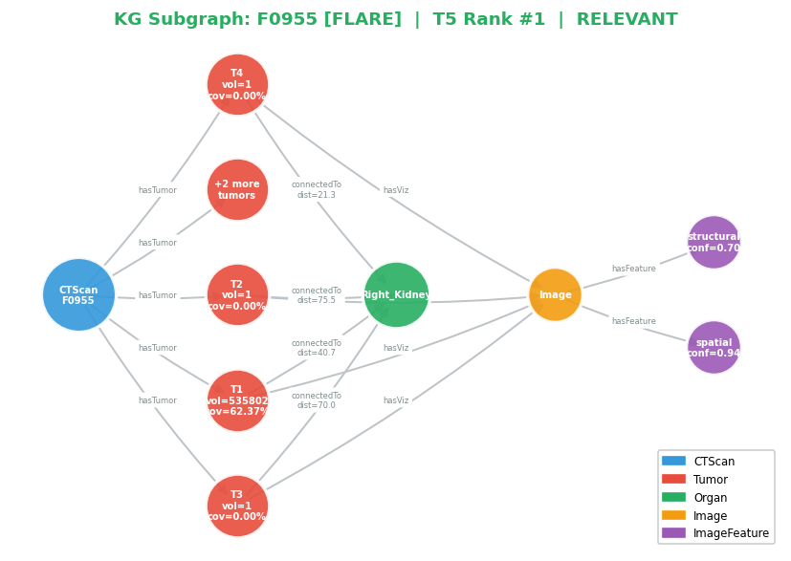

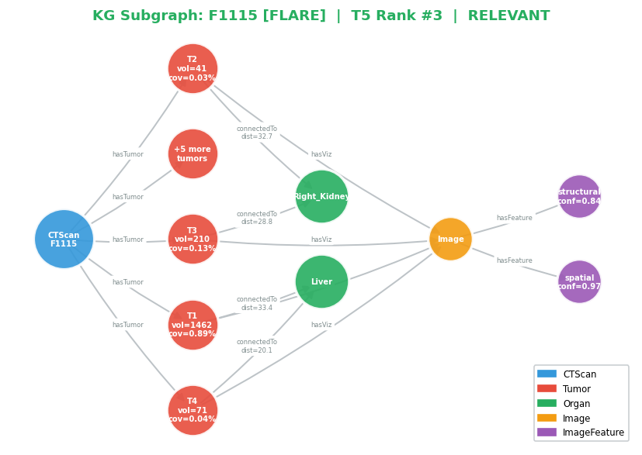
Case 4: Volume + Containment [FLARE] — T5 KG Subgraphs (10/20 relevant in top-10)
Query: "Find scans with high tumor volume AND complex organ topology." | CLIP completely reshuffles top-10 at T3.
#1 F0955 [FLARE] (RELEVANT)
#2 F1314 [FLARE] (RELEVANT)
#3 F1115 [FLARE] (RELEVANT)
Score: 0.936
Score: 0.908
Score: 0.899
T5 adds VKG reasoning features (path completeness, topology diversity, adjacency density). Subgraphs show that correctly retrieved scans tend to have richer KG structure — multiple organs, more tumors, complex paths.

Slide 42
Case 4: Volume + Containment [FLARE] — T1 vs T5: Top-1 Retrieved Scan Comparison
Query: "Find scans with high tumor volume AND complex organ topology."
T1 Top-1: #1 F1273 [FLARE] (irrelevant) | Score: 1.000
T5 Top-1: #1 F0955 [FLARE] (RELEVANT) | Score: 0.936
→

Slide 43
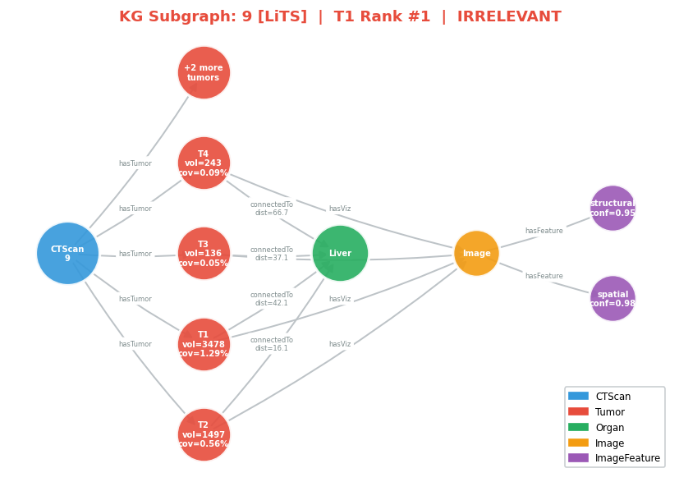

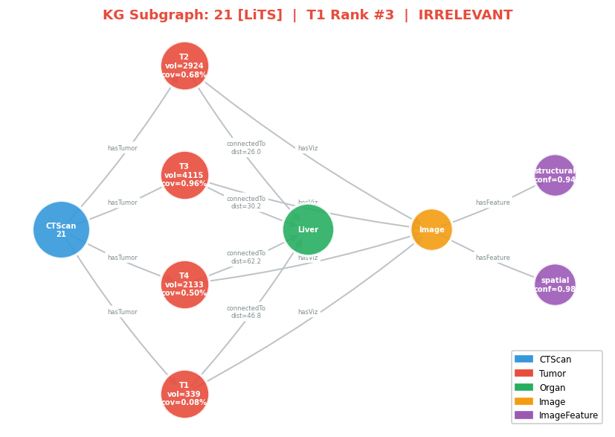
Case 5: Volume + Proximity + Containment [LiTS] — T1 KG Subgraphs (3/6 relevant in top-10)
Query: "Find scans with high volume AND close proximity AND complex topology." | Only T5 achieves perfect 6/6 retrieval.
#1 9 [LiTS] (irrelevant)
#2 8 [LiTS] (irrelevant)
#3 21 [LiTS] (irrelevant)
Score: 0.873
Score: 0.863
Score: 0.862
T1 uses only tabular features (volume, coverage, distance). Subgraphs show that top-ranked scans may have simple KG structure — fewer connections, fewer organs, simpler topology.

Slide 44
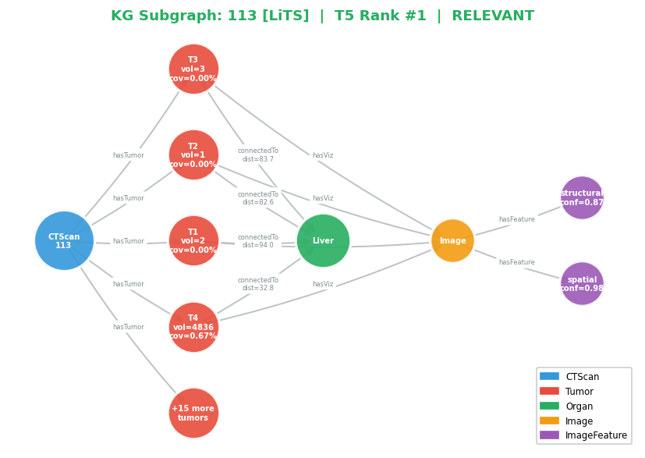


Case 5: Volume + Proximity + Containment [LiTS] — T5 KG Subgraphs (6/6 relevant in top-10)
Query: "Find scans with high volume AND close proximity AND complex topology." | Only T5 achieves perfect 6/6 retrieval.
#1 113 [LiTS] (RELEVANT)
#2 58 [LiTS] (RELEVANT)
#3 103 [LiTS] (RELEVANT)
Score: 0.960
Score: 0.943
Score: 0.939
T5 adds VKG reasoning features (path completeness, topology diversity, adjacency density). Subgraphs show that correctly retrieved scans tend to have richer KG structure — multiple organs, more tumors, complex paths.

Slide 45
Case 5: Volume + Proximity + Containment [LiTS] — T1 vs T5: Top-1 Retrieved Scan Comparison
Query: "Find scans with high volume AND close proximity AND complex topology."
T1 Top-1: #1 9 [LiTS] (irrelevant) | Score: 0.873
T5 Top-1: #1 113 [LiTS] (RELEVANT) | Score: 0.960
→

